Slide 1

Annual Court Reporting Toolkit -
Additional Documentation
Available at: http://www.fedcourt.gov.au/pjdp/pjdp-toolkits
Toolkits are evolving and changes may be made in future versions. For the latest version of this Additional Documentation please refer to the website – Available at: http://www.fedcourt.gov.au/pjdp/pjdp-toolkits
Note: While every effort has been made to produce informative and educative tools, the applicability of these may vary depending on country and regional circumstance.
PJDP is funded by the Government of New Zealand and managed by the Federal Court of Australia

Slide 2

PACIFIC JUDICIAL
DEVELOPMENT PROGRAMME
Court Reporting Workshop
16-18 October, 2013 Brisbane
Cate Sumner,
PJDP Judicial Monitoring and Evaluation Adviser
Leisha Lister
Co-Facilitator
PJDP is funded by the Government of New Zealand and managed by the Federal Court of Australia

Slide 3

PJDP Goal
Strengthened governance and rule of law in Pacific Island Countries through enhanced access to justice and professional judicial officers who act independently according to legal principles.

Slide 4
Outset of PJDP: Findings:
No court baseline data exists that can be applied across the region.
There is no clear understanding about how judicial and court baseline data can be used to improve the administration of justice across the region.
There is an unquantified number of marginalised/ disadvantaged prospective court users facing a range of barriers in accessing the courts.
…
  …
  …
  …

Slide 5
18 Month Target set by PJDP:
The majority of PJDP courts have baseline data against which changes can be measured, and
a Regional Justice Performance Framework endorsed by Chief Justices that courts will work to achieve with capacity building support from PJDP.

Slide 6
15 Cook Island Indicators
Case management issues.
Indicators developed in the Cook Islands in 2011 by PJDP Chief Justices and National Coordinators:
Case finalisation or clearance rate.
Average duration of a case from filing to finalisation.
The percentage of appeals.
Overturn rate on appeal.

Slide 7
15 Cook Island Indicators
Affordability and Accessibility for court clients.
Percentage of cases that are granted a court fee waiver.
Percentage of cases disposed through a circuit court.
Percentage of cases where a party receives legal aid.

Slide 8
15 Cook Island Indicators
Published procedures for the handling of feedback and complaints.
Documented process for receiving and processing a complaint that is publicly available.
Percentage of complaints received concerning judicial officers.
Percentage of complaints received concerning court staff members.

Slide 9
15 Cook Island Indicators
Resources and Transparency
Average number of cases per judicial officer.
Average number of cases per member of court staff.
Court produces or contributes to an Annual Report that is publicly available.
Information on court services is publicly available.
Court publishes judgments on the Internet (own website or on PacLII)

Slide 10
Workshop Objectives
By the end of this workshop participants should be able to:
  Explain the purpose of an annual report.
  List the different court stakeholder groups and what they will be interested to see included in the Annual Report;
  Describe the different categories of information to be included in the Annual Report.

Slide 11
Workshop Objectives cont.
  Explain who should be involved in the process of drafting an Annual Report and their roles;
  Draw up a timeline of steps to be taken to publish an Annual Report in the following year.
  Present a draft Annual Report plan to their Chief Justice in relation to the next Annual Report to be published in their country that includes how their current Annual Report could be improved.

Slide 12
Objective: Session 1
By the end of the sessions participants will be able to:
  Explain the purpose of an annual report.
  List the different court stakeholder groups and what they will be interested to see included in the Annual Report.

Slide 13
Why do we have an Annual Report?
  “Annual reports represent the vehicle through which courts take ownership of the work they have completed during the year and present to the public their annual results against key performance indicators. In doing so they win the trust of the public and are accountable to the citizens they serve”.
  2011 PJDP Baseline Report

Slide 14
Annual Report Purpose
“Excellent courts use a set of key-performance indicators to measure the quality, efficiency, and effectiveness of their services. Courts should, at the very least, collect and use information on the duration of proceedings and other case-related data. Excellent courts aim at shifting their data focus from simple inputs and outputs to court customer satisfaction, quality of service, and quality of justice”.
- International Framework for Court Excellence p33

Slide 15
Annual Report Purpose
#4.5 – “The judiciary should regularly address court users’ complaints, and publish an annual report of its activities, including any difficulties encountered and measures taken to improve the functioning of the justice system”.
- Measures for the Effective Implementation of the Bangalore Principles

Slide 16
Annual Report Purpose
Good governance, accountability, & transparency.
Informs the Parliament, external stakeholders (eg. educational, research institutions, media, NGO’s & the general public) about the performance of Courts.
They are a key reference document
  For internal management
  Strategic planning & performance
  Form part of the historical record of the court

Slide 17
Annual Report Purpose Cont.
  They set out Court Budget Statements:
    The allocation of resources to achieve Government outcomes
    The performance information targets
    The achievement (or not) of these performance & financial targets.
  They enable the court to:
    Establish a culture of reporting, planning & management of services
    Respond to external concerns & pressures eg. Client survey results, new projects
    Report on achievements & successes
    Explain the purpose of the court – “what you can & cannot do”

Slide 18
What is the value of an annual report?
Reporting has an internal value
  Strengthens the delivery of services for clients – shows where the court is not performing well
  Improves ability to obtain budget increases
  Allows the court to make changes to case processes based on trend data
External value
  Accountability to government, the public and to clients which strengthens confidence in the courts
  Shows that the court is responsive to client feedback and needs

Slide 19
Who is the audience?
Annual Reports may be written for:
External audience
  Parliament/Minister
  Lawyers/clients/service providers
  The public
  NGOs & representative bodies (eg. UNICEF, UN Women, NGOs, women’s & men’s groups)
  Educational institutions & researchers
  Other courts (local & international)
Internal audience
  Judiciary, management, staff

Slide 20
What do stakeholders want to see?
Stakeholders want:
Clear, concise, relevant, consistent & accurate information
Reports that present an honest & balanced snapshot of the courts achievements
Results, targets and trends over time (the good, the bad & the ugly)
Information as to why a target/performance was not reached & what the court is doing about it
Information presented in plain language, in an easy to read format preferably supported by charts, diagrams & pictures

Slide 21
What is the purpose of an Annual Report?
**Group Exercise:
Are there statutory responsibilities to issue an Annual Report in your country? If yes, what are these?
Does the court have to publicly account for state budget resources that it receives?
If there is not a statutory responsibility, what are the benefits of issuing an Annual Report?
  For the court.
  For court stakeholders
Who are the ‘stakeholders’ for your Court’s annual report? What would they want to know?

Slide 22
Objective: Session 2
By the end of the sessions participants will be able to:
  Describe the different categories of information to be included in the Annual Report
  Explain who should be involved in the process of drafting an Annual Report and their roles as well as timelines.

Slide 23
How to Approach an Annual Report?
Use the ‘Annual Report Template’ as a guide & for each of the following sessions note for your country:
  Discuss what aspects of your court’s work should be included in the Annual Report and why?
  Who should be responsible for drafting different sections in the Annual Report?
  Who should approve the content of the Annual Report?
  What is the timeline for completion of each section and the whole Annual Report?

Slide 24
Framework for an Annual Report
  An introduction to the court.
    Statement from the Chief Justice
    Court Mission, Vision and Values
    Implementation of the Strategic Plan/ New initiatives
    What does your Court feel most proud of achieving in the last year?
    What challenges has the court faced in delivering the level of service to clients it would like?
    Overview of the Courts and their jurisdiction
    Introduction to Judges and Court Staff and their roles
    Court locations

Slide 25
Framework for an Annual Report
        Court results
        Court achievements in the reporting period
        Court workload
        Court performance against Key Performance Indicators (15 Cook Island indicators)
        Showing trend data for the past 3-5 years, where possible.
        Interaction with Key Court Stakeholders/ How has the court engaged with key stakeholders over the year to obtain feedback on the level of service provided to clients?
        Annual Accounts for Reporting Period

Slide 26
Cook Island Indicators 1 to 4 - Case Management
Case finalisation or clearance rate.
Average duration of a case from filing to finalisation.
The percentage of appeals.
Overturn rate on appeal.

Slide 27
1: Case finalisation or clearance rate
  A: List Courts
  B: List Case types that are currently differentiated by your court.
  C: Calculate number of cases filed in the reporting period disaggregating by A and B.
  D: Calculate number of cases finalised in the reporting period disaggregating by A and B.
  E: Clearance rate (%) = finalised cases/ cases filed for the reporting period x 100

Slide 28
2: Average duration of a case from filing to finalisation
  A: List Courts
  B: List Case types that are currently differentiated by your court.
  C: List cases finalised in the reporting period disaggregating by A and B.
  D: For list of cases in C, subtract date of filing from date of finalisation to obtain the number of days per case (use excel)
  E: For C, add the number of days per case and divide by the number of cases to obtain the average duration of a case.

Slide 29
Trend Data: RMI criminal cases 2011

Slide 30
Trend and Disaggregated Data
Aim to:
  show data for the clearance rate and average duration of a case over a 3-5 year time frame,
  Disaggregate by type of case: civil, criminal, land
  Disaggregate by age: juvenile criminal cases
  Disaggregate by important classes of case: family violence/ Interim Protection Orders/ Violence against women and children cases.

Slide 31
Trend Data: Vanuatu criminal cases 2011

Slide 32
Trend Data: Tokelau criminal cases 2011 gender disaggregated

Slide 33
Trend Data: Tokelau criminal cases 2011 AR – age disaggregated

Slide 34
Indicators 3 & 4 - Appeals.
# 3 - The percentage of appeals.
# 4 - Overturn rate on appeal.
Calculate by:
    List Courts and number of first instance cases finalised in the reporting period;
    List cases appealed from one level of court to another.
    List number of cases in which the appeal is allowed in whole or in part.
    Percentage of appeals = b/a
    Overturn rate on appeal = c/b

Slide 35
RMI: Appeals 2011 AR

Slide 36
Cook Island Indicators 5 to 7 - Affordability and Accessibility
Percentage of cases that are granted a court fee waiver.
Percentage of cases disposed through a circuit court.
Percentage of cases where a party receives legal aid.
  Cost - Distance – Knowledge of the law/ rights

Slide 37
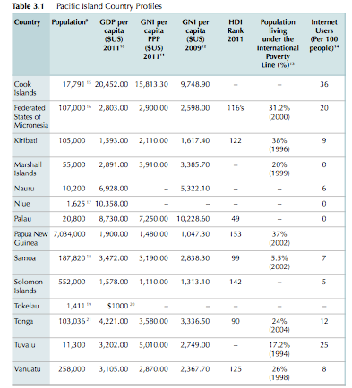
Slide heading
Slide sub-heading (if required)
Use of…
…
  …
  …
  …

Slide 38
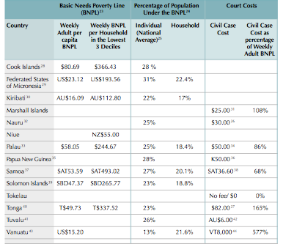
Slide heading
Slide sub-heading (if required)
Use of…
…
  …
  …
  …

Slide 39
Cook Island Indicators 5-7: Affordability and Accessibility
  For each court list the number of cases finalised in the reporting period;
  For each court list the number of cases where the court fee is waived (civil cases);
  For each court list the number of cases finalised at a circuit court location;
  For each court list the number of cases where one or party receives legal aid in the case;
  Percentage of cases that are granted a court fee waiver = b/a x 100 = total%
  Percentage of cases disposed through a circuit court = c/a x 100 = total%
  Percentage of cases where a party receives legal aid = d/a = total%

Slide 40
RMI 2011 AR: Affordability and Accessibility

Slide 41
Trend Data
Aim to:
  show data affordability and accessibility indicators over a 3-5 year time frame,
  Disaggregate by type of case: civil, criminal, land
  Disaggregate by age: juvenile criminal cases
  Disaggregate by important classes of case: family violence/ Interim Protection Orders/ Violence against women and children cases.

Slide 42
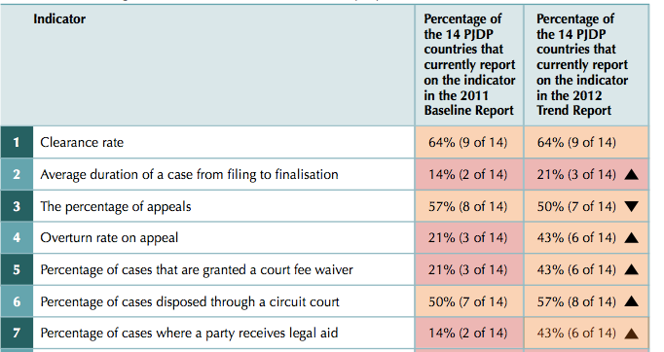
Percentage of the 14 PJDP countries that currently report on the indicator

Slide 43
Palau
Court fee waiver provisions.
http://www.palausupremecourt.net
Click Fees Tab
Scroll to base of document where you see:
Note that fees may be waived by the court of proper jurisdiction if the Plaintiff or Petitioner files a request form. The form is available online or at the Clerk of Courts .(Form in materials for participants).
A Supreme Court Order was signed in December 2011 amending the Civil Procedure Rules to include a fee waiver.

Slide 44
Vanuatu
Family Protection Act No 28 of 2008
Section 41: No Application Fees
Despite the provisions of any other Act or law, no fees or charges are payable to a court or an authorised person in relation to the making of an application for a family protection order (for example, there can not be any court filing fees for the application).

Slide 45
RMI
http://www.rmicourts.org
Click on Court Rules
Click on Schedule of Court Costs and Fees November 2011
VIII In Forma Pauperis Anyone who is unable to pay the fees set forth in this rule may petition the court to proceed in forma pauperis pursuant 29 MIRC 136

Slide 46
Cook Island Indicators 8 to10
#8. Documented Complaint Handling & Feedback
Documented process for receiving & processing complaints in the annual report
Judicial Code of conduct may form the basis
Underpins accountability & transparency
Opportunity to report against a performance standard i.e standard for responding to complaints
Publically available – internet, brochure, complaint & feedback box
  Kiribati
  RMI
  Palau

Slide 47
Cook Island Indicators 8 to 10
#8. Example: RMI Annual Report

Slide 48
Cook Island Indicators 8 to 10
#8. Example: FCoA Complaint Handling Performance Standards

Slide 49
Cook Island Indicators 8 to 10
# 9. Percentage of Judicial complaints per total cases
Most often relate to:
  Delay in the delivery of a judgment
  Judicial conduct
NOT about dissatisfaction of the outcome in a case
Important to report as it shows that the Court:
  take complaints seriously
  are accountable & transparent
Provides an opportunity for the Court to detail complaint handling process.
Calculate: number of complaints received about a judicial officer divided by the total number of cases filed multiplied by 100 which will provide the percentage

Slide 50
Cook Island Indicators 8 to 10
# 9. Example: Complaint Handling – Judicial Officers

Slide 51
Cook Island Indicators 8 to 10
#9. EXAMPLE: Complaint Handling Judicial

Slide 52
Cook Island Indicators 8 to 10
#10. Percentage of complaints about Court Staff per cases filed
Provides an opportunity for the court to:
  Show that it takes the complaint seriously
  Is responsive to concerns from the public
  Detail the types of complaints received and the internal changes that may occur as a result i.e changes to forms in the FCoA
  Explain what the court can & can not do – i.e. FCoA complaints about legal vs procedural advice

Slide 53
Cook Island Indicators 11 to 12
#11. Average number of cases per judicial officer
Indicator details the average number of cases per judicial officer
Important because it details ratio of cases per judge/per region i.e is there adequate judicial officers/equity/performance
Need to consider how data is collected and reported when there is more than 1 judicial officer presiding in a case (e.g. panel of 3 judges)
Calculate: divide the total number of cases filed by the number of judicial officers

Slide 54
Cook Island Indicators 11 to 12
#12. Average number of cases per court staff
Indicator looks at the average number of cases per court staff member
Important because it:
  Shows ratio (too small in some regional areas/courts – redirect resources)
  High ratio may impact on efficiency and performance – affect timelines & result in complaints
Allows the court to develop performance standards
Calculate: divide the total number of cases received by the number of court staff (non-judicial)

Slide 55
Cook Island Indicators 13 to15 Transparency
Court produces or contributes to an Annual Report that is publicly available.
Information on court services is publicly available.
Court publishes judgments on the Internet (own website or on PacLII)

Slide 56
Transparency Cont.
Group discussion in country groups:
  Does your Court produce or contribute to an Annual Report that is publicly available?
  Is the publication of your Court Annual Report coordinated with other agencies such as the MoJ? Does this have an impact?
  Is your Annual Report published in the year following the reporting period?
  Is the Report Publicly available? On PacLII? On National court or MoJ website?
  Other issues affecting publication of an Annual report?

Slide 57
Cook Island Indicators 13-15: Transparency

Slide 58
  Information on court services is publicly available.

Slide 59
  Court publishes judgments on the Internet (own website or on PacLII)

Slide 60
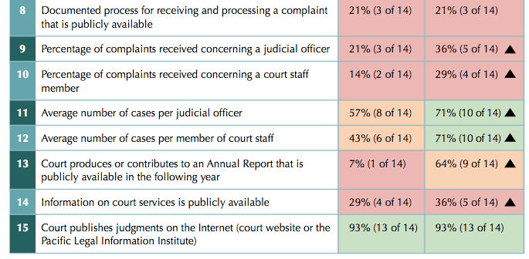
Percentage of the 14 PJDP countries that currently report on the indicator

Slide 61
Cook Island Indicators 13-15: Transparency
Discuss in country groups:
  What prevents case judgments being uploaded quickly to PacLII?
  What court information do court stakeholders need access to:
    Lawyers
    Clients
    Witnesses
    Victims of Crime
    How can this be presented to them?
    Examples: PNG? Family Court of Australia?

Slide 62
Reporting on family violence and children’s cases.
Discuss in Country Groups:
Why should Annual Reports include data on:
  the number of family violence cases/ protection order applications commenced by women / other VAW cases?
  The number of children’s cases including the outcome of the case and the type of sentence that may be imposed.

Slide 63
Juvenile Cases
Data on cases disaggregated to indicate whether the case involves children as perpetrators or victims of crimes are important in order to deliver better justice services to children. In the 2011 PJDP Baseline Report, the Republic of the Marshall Islands was the only PJDP country to include juvenile justice data in its Annual Report.

Slide 64
Juvenile Cases Cont.
The United Nations Children’s Fund (UNICEF) has published baseline reports for Kiribati, Solomon Islands and Vanuatu in 2009 and the Republic of Palau and the Republic of the Marshall Islands in 2013. Baseline reports for Samoa and the Federated States of Micronesia are currently being prepared.

Slide 65
Juvenile Cases: 2012 Trend report

Slide 66
Juvenile Cases: 2012 Trend Report

Slide 67
Annual Report: Marshall Island

Slide 68
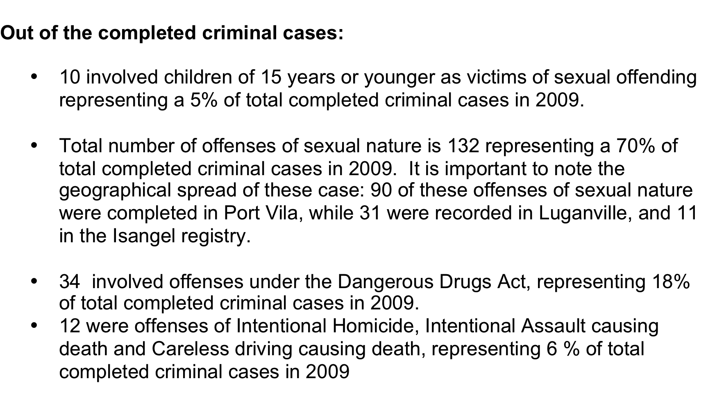
Vanuatu Annual Report

Slide 69
Annual Report: Juvenile Data
Review Data for the last annual reporting period and:
  List the number of children’s cases (children as a victim of a crime or as an accused)
  The finding in the case (guilty/ not guilty)
  The sentence in the case
  The duration of the case

Slide 70
Gender Disaggregated Data: 2012 Trend Report

Slide 71
Gender Disaggregated Data: 2012 Trend

Slide 72
Annual Reporting: Gender Considerations
Review Data for the last annual reporting period and:
  List the number of (i) domestic/ family violence cases and (ii) protection order applications commenced by women each year,
  an average duration from filing to finalisation for these cases, and
  an indication of whether the case is resolved in favour of the applicant party for the protection order.

Slide 73
Objective: Session 4
How to make an Annual Report Better?
By the end of the session participants will be able to:
Identify areas where the Annual Report can be improved.
  Present a timeline of steps to be taken to publish the Annual Report in the following year, including who is responsible for what and by when.
  Present a draft Table of Contents of the Annual Report (including examples of tables).

Slide 74
How does your Annual Report measure up?
Critically assess your current Court Annual Report against the following criteria rating it from 1 (poor) to 5 (excellent). Does the Annual Report :
  assess performance against standards that have been set by your Court, and, if the court has not achieved the performance standards, explain why and what steps the court is taking to remedy this?
  presents trends in performance over a 3-5 year period?

Slide 75
How does your Annual Report measure up?
present the Court’s performance against a range of quantitative performance indicators?
present the Court’s performance against a range of quantitative performance indicators from surveys, other evaluations ?
use plain language, relevant diagrams and a clear format to illustrate and add emphasis?

Slide 76
Approach
Take the Table of Contents developed for the Annual Report in Session 2 and show:
  A date for when each section should be completed
  Who will be responsible for drafting it.
  When a consolidated draft Annual Report will be sent to stakeholders for their input.
  When a draft final Annual Report will be sent to the Chief Justice/ Chief Magistrate/ Minister.
  Estimated date for tabling the Annual Report in Parliament.
  How the Annual Report will be published: on-line/ print

Slide 77
Thank you

