Slide 1



Managing and Reporting on Fraud and Corruption Cases
Online Course
Via Zoom 20 & 27 July, 3 & 10 August 2023
Notes:
Open, Prayer

Slide 2
Session 1: Course Introduction
Thursday 20 July 2023

Slide 3

Session 1 - Agenda
Welcome & Course Introduction (30 minutes)
Presentation on Ethics, Fraud & Corruption (30 minutes)
Discussion Questions (20-30 minutes)
Introduction to next week’s session (5 minutes)
Session Wrap-Up (5 minutes)

Slide 4
Pacific Judicial Integrity Program
Funded by the Australian Government
Implemented in partnership between the Papua New Guinea Centre for Judicial Excellence & the Federal Court of Australia
Working with 12 partner courts
March 2022-April 2025

Slide 5
Goal and Outcomes
To support registrars and court officers to manage and report on fraud and corruption-related cases
Specialist in-person and online training
Mentoring, networking and resources

Slide 6
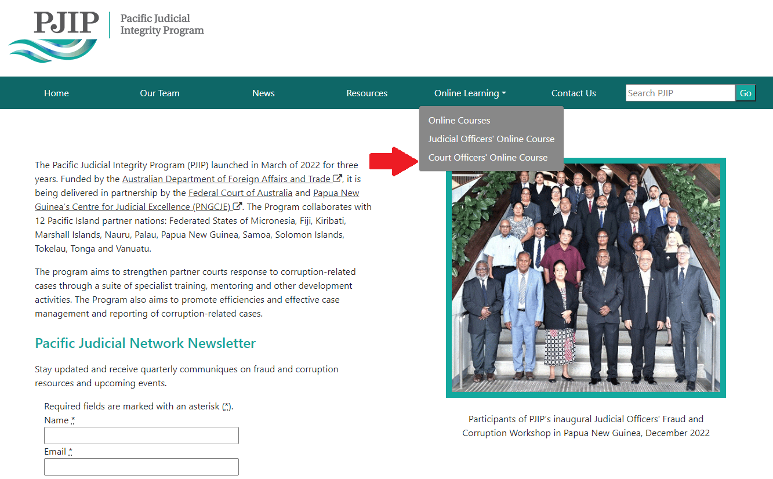
Website
URL: https://www.fedcourt.gov.au/pjip

Slide 7
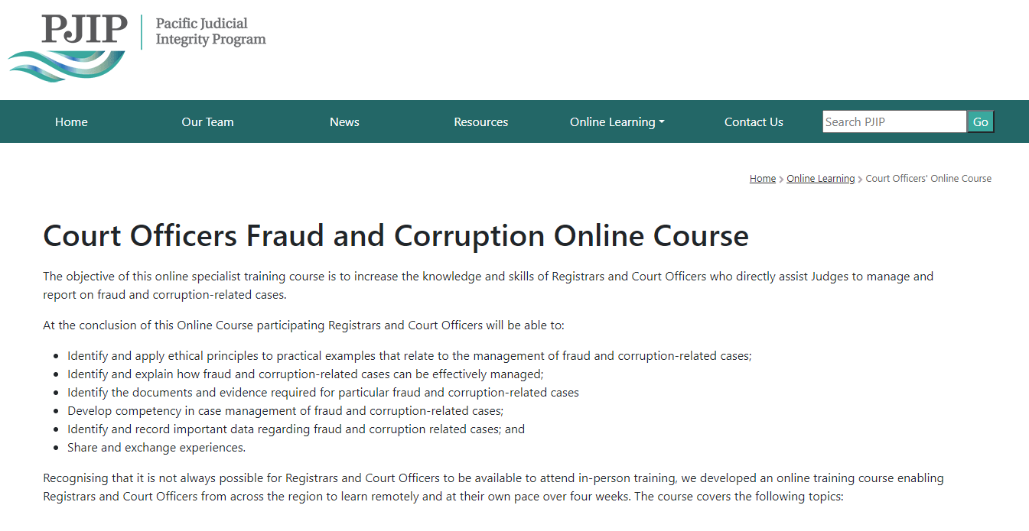
Website
URL: https://www.fedcourt.gov.au/pjip

Slide 8
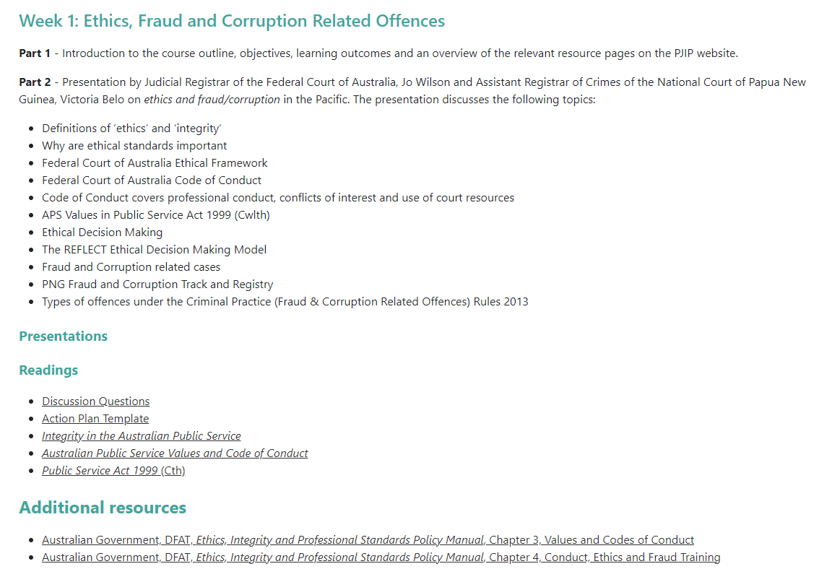
Website
URL: https://www.fedcourt.gov.au/pjip

Slide 9
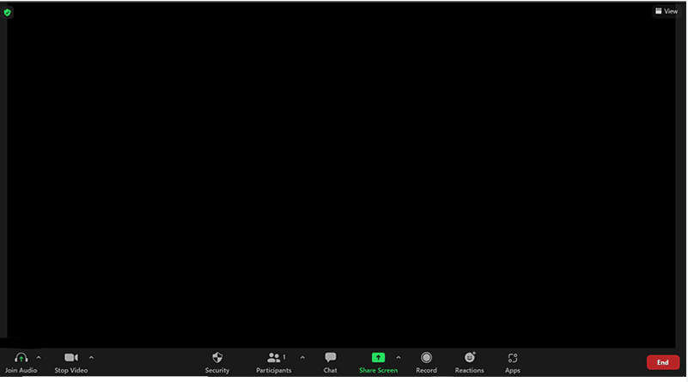

Using Zoom – The Basics
This button allows you to text chat with all the participants
This button allows you to share your phone or computer screen with the other participants
This button mutes your audio, so that no one can hear you
This button allows you to choose to display your webcam, or not
This button lists all of the participants in the Zoom meeting

Slide 10

Introductions
Please introduce yourself and what court you are from?
Is there a particular question that you would like answered regarding a court officer’s role with respect to managing and reporting on fraud and corruption related cases from this online course?
Introduction of the course presenters

Slide 11

Objective of the Online Course
The objective of this online specialist training course is to increase the knowledge and skills of registrars, judicial associates and court officers who directly assist Judges to manage and report on fraud and corruption-related cases.

Slide 12
Outcomes of the Online Course
At the conclusion of this online course participating Court Officers will be able to:
identify and apply ethical principles to practical examples that relate to the management of fraud and corruption-related cases;
identify and explain how fraud and corruption-related cases can be effectively managed;
identify the documents and evidence required for particular fraud and corruption-related cases;
develop competency in case management of fraud and corruption-related cases;
identify and record important data regarding fraud and corruption-related cases; and
share and exchange experiences.

Slide 13

Online Course
Live online sessions each Thursday afternoon for 2 hours for 4 weeks on Zoom
First session Thursday 20 July 2023
You will be emailed a link and instructions to access the weekly online sessions
The course will focus on two (Fraud and Bribery) of the five identified most prevalent fraud and corruption-related case types/categories heard across the Pacific.

Slide 14
Online Session Topics
Session
Topic & Facilitator
Session 1: Thursday 20 July
Session 2: Thursday 27 July
Session 3: Thursday 3 August
Session 4: Thursday 10 August
Ethics & Fraud/Corruption
Victoria Belo & Jo Wilson
Bribery
Alicia Ditton
Procedural Steps & Documents
Victoria Belo & Jodie Burns
Case Management Systems
Shemi Joel & Tony Lansdell

Slide 15
Managing and Reporting on Fraud and Corruption Cases Online Course
Session 1: Ethics, Fraud & Corruption
Presenters: Assistant Registrar Victoria Belo, National Court of PNG
Judicial Registrar Jo Wilson, Federal Court of Australia

Slide 16

Ethics - Important Definitions
qualities that describe a common understanding of the proper way to behave
include such qualities as respect and trustworthiness
are the principles that guide our behaviour

Slide 17

Important Definitions
Integrity:
Alignment between ethical standards and our actions.
When integrity is compromised, it undermines confidence in our ability to do the right thing.

Slide 18

Understanding ethics
Ethical standards are our integrity guide to how we act and make decisions.
When we act with integrity, the community can trust that we are working to a standard that is ethical, fair and appropriate.
By understanding our obligations, we minimise the potential for risks to our integrity, and contribute to a strong and positive culture that promotes trust in us by the community.

Slide 19

Federal Court of Australia -
Ethical Framework
The ethical obligations that apply to all Federal Court employees arise from:
Australian Public Service (APS) Code of Conduct
APS Values
APS Employment Principles

Slide 20

FCA Ethical Framework
The Code of Conduct covers issues such as:
Professional conduct
Conflicts of interest
Use of court resources

Slide 21

1. Professional Conduct
Includes:
Acting honestly
Acting with care and due diligence
Complying with the law
Complying with lawful and reasonable directions of supervisors
Maintaining confidentiality

Slide 22

2. Conflicts of interest
Includes both real and perceived conflicts of interest, including:
taking reasonable steps to avoid any conflict of interest (real or apparent) in connection with our duties; and
disclosing details of any material personal interest as soon as we become aware of it, so that the risks can be managed.

Slide 23

3. Use of court resources
All employees must:
use court resources in a proper manner and for a proper purpose.
must not provide false or misleading information in response to official requests for information.
must not improperly use inside information or the employee’s power or authority to:
  - obtain a benefit or advantage for themselves or someone else; or
  - cause detriment to either the court or another person.

Slide 24
Ethical Frameworks
The APS Values set out in Public Service Act 1999. Provide court officers with markers on what the highest standard or integrity looks like:
Impartial - apolitical
Committed to service - we are professional, objective, innovative and efficient, and work collaboratively to achieve the best results for our community.
Accountable - open and accountable to the community under the law.
Respect - We respect all people and cultures, including their rights and their heritage.
Ethical - We demonstrate leadership, are trustworthy, and act with integrity, in all that we do.

Slide 25
Ethical Frameworks
The APS Employment Principles provide that the workplaces of the court:
are flexible, safe and rewarding, where communication, consultation, cooperation and input from employees on matters that affect their workplaces is valued
are free from discrimination, patronage and favouritism Respect
recognise the diversity of our community and foster diversity in the workplace

Slide 26

Ethical decision making
At times we will be faced with difficult ethical decisions. Exercising good judgment and navigating complex issues is a key part of our roles in the justice system.
The ‘REFLECT’ model can help us to unpack integrity issues and provide a roadmap for ethical reasoning

Slide 27
REFLECT Model
Roadmap for ethical decision making
REcognise a potential issue or problem
Find relevant information
Linger at the ‘fork in the road’
Evaluate the options
Come to a decision
Take time to reflect

Slide 28

Fraud & Corruption Cases
We will consider how court officers deal with fraud and corruption related offences

Slide 29

PNG Fraud & Corruption Track
National Court Registry under the Criminal Division is divided into two tracks, the General Crimes track and the Fraud & Corruption track.
Special track created by Criminal (Fraud & Corruption Related Offences) Rules 2013

Slide 30
Purpose of PNG Fraud &
Corruption Track
to facilitate a quick, fair and efficient disposition of Fraud and Corruption cases under a special track.
to distinguish Fraud Offences as opposed to other Criminal offences and can be dealt with separately
Who manages this Track?

Slide 31
Fraud & Corruption Track
Registry
The Committal Courts (District Courts) commits an accused to National Court to stand trial
Clerk of the Committal Court forwards the Notice of Committal, the Information and other relevant documents to the Fraud and Corruption Track Registry

Slide 32
Fraud & Corruption Track
Registry
After receipt of documents clerks will register the matters under either CR (FC) No of year for normal fraud and corruption cases, for special applications under OS (FC) No of (year) and appeals and reviews from the District Court will be registered as CR (APP) (FC) No of (year)

Slide 33
Fraud & Corruption Track
Registry
After registering the case it is listed before judge for mention, direction and other listings until the matter goes for trial & the Court makes a decision on the verdict and later sentence if the person is found guilty.

Slide 34

Types of offences under the Criminal Practice (Fraud &
Corruption Related Offences) Rules 2013
Include:
offences under the Criminal Code or under any other law involving theft, fraud, dishonesty and misappropriation of property and including fraud and corruption
(b) offences listed in the Schedule of the Rule
(c) applications under the Proceeds of Crime Act 2005 or the Mutual Assistance in Criminal Matters Act 2005.

Slide 35
Fraud offence types under the
Schedule
Refer to the Schedule in the Criminal Practice (Fraud & Corruption Related Offences) Rules 2013. The sections referred to beside the offence types are sections of the Criminal Code Act.
Offences against the executive and legislative power (ss 57, 59, 61 & 62)
Disclosing official secrets (ss 84,85 and 86)
Corruption and abuse of office (ss 87 – 97C)
Secret Commission (ss 97G – 97 N)
Corrupt and Improper Practice at elections (ss 99 – 102, 104 – 106 and 108 – 116)
Selling and trafficking in offices (ss 117)
Offences relating to the Administration of Justice (119 – 136)
Obstructing officers of courts (ss 143)
Offences relating to currency (ss 146 – 162)
Offences relating to posts and telegraphs (ss 169 – 189 and 91 &92)
Miscellaneous offences against public authority (ss 195 – 197)
Offences against public health (ss 237 – 240)
Miscellaneous offences (ss 241 – 242)
Offences against liberty (ss 356 – 357)
Offences relating to parental rights and duties(ss 361)
Stealing and similar offences (ss 372 – 419)
Forgery and like offences: personation (ss 462 – 491)
Offences connected with trade and breach of contract Fraudulent debtors & offences relating to falsification of companies registers, etc (ss 493 – 507)

Slide 36
Fraud & Corruption in PNG
court deals with perpetrators
it cannot go out to find out who is doing these illegal activities
court needs the help of police to carry out their work diligently to investigate and bring in evidence to hold those responsible liable.
onus is also on citizens to help our country by reporting such illegal practices to the police so that the perpetrators are arrested brought to Court and are dealt with according to law.

Slide 37
Discussion Questions
Is your court bound by a Code of Conduct?
  If yes, identify one obligation that it imposes upon you as a court officer.
  If not bound by a Code of Conduct, what other rules apply to impose obligations on you as a court officer to act ethically?
The REFLECT is a model for ethical decision making. What are the advantages of using a model such as this when confronted with an ethical issue?
Does your court have a specific track for fraud and corruption related cases (like PNG)? What are the advantages for both the court and court users in having a dedicated track for these cases?

Slide 38
Action Plan
Throughout the duration of the Online Course we will be discussing ideas and suggestions that may be of interest to your Court.
An Action Plan template has been emailed to you.
Over the next week, please meet with your colleagues and consider any key ethic or fraud/corruption actions that you may wish to consider implementing in your Court.

Slide 39

Next Week:
Session 2 - Bribery
Thursday 27 July 2023
12-2pm (GMT+10:00)
Use same Zoom link
You will be emailed a scenario on bribery. Please come ready to discuss this scenario
Presenter: Judicial Registrar, Alicia Ditton

Slide 40
Due to varying locations, local time zones for
Session 2 are as follows:
Thursday 27 July, 2023
11:00am | Palau
12:00pm | Australia Papua New Guinea
1:00pm | Federated States of Micronesia Solomon Islands Vanuatu
2:00pm | Fiji Kiribati Nauru Republic of Marshall Islands
3:00pm | Tonga Samoa Tokelau

Slide 41
See you next week!

