Slide 1
Managing and Reporting on Fraud and Corruption Cases Online Course
Via Zoom 20 & 27 July and 3 & 10 August 2023

Slide 2
Session 4 - Agenda
Welcome & Introduction (10 minutes)
Presentation on Case Management Systems (50 minutes)
Discussion Questions (20 minutes)
Sharing of one key take away (15 minutes)
Post-Course Survey (10 minutes)
Course Wrap-Up (5 minutes)

Slide 3
Managing and Reporting on Fraud and Corruption Cases Online Course
Session 4: Case Management Systems
Presenters: Tony Lansdell, PJIP Systems Adviser
Chief Registrar Shemi Joel, Supreme Court of Vanuatu
Ingrid Kabua, Chief Clerk of Courts, Marshall Islands Judiciary

Slide 4
Topics
Systems
  Overview of Systems across the Pacific
Data
  Criminal data structure
  Data management and quality
  Reporting and Analysis
  Vanuatu/RMI – ensuring data quality focus
Documents
  Creating the e-file
  Using the e-file
  Features needed
  Vanuatu/RMI – experience with documents
Active Case Management
  Managing cases
  Vanuatu/RMI – experience with ACM

Slide 5
Systems

Slide 6

Case Management System
Without information – we know nothing
We can’t answer questions, we can’t plan, we can’t reflect
CMSs serve two purposes – the case itself, and the management of 1,000s – with two audiences – the judiciary and the administration
  Documents get the judiciary excited
  Information gets the administration excited

Slide 7
Case Management System continued
While the scope of PJIP is a subset of the totality of what a court deals with criminally, all the points/topics in this course relate to either the subset or the totality of criminal matters or ANY large matter
Three key ingredients for judicial officers and administrators with the USE of systems:
  Data
  Documents
  Active Case Management

Slide 8
Systems in the Pacific
Country | Systems | Documents | Judicial Usage | Criminal Alignment
Vanuatu | Established CMS | Yes | Variable
FSM | CTS | Yes | Minimal | Under development
Tokelau | XLS (to be enhanced) | No | N/A | Free text (to be enhanced)
Nauru | CTS | Yes | Minimal
Fiji | Moving to CMS | Unsure | Unsure | Unsure
Tonga | New CMS | Yes | Variable
Samoa | CTS | Yes | Will be
PNG | Various CMS | Yes | Substantial
Solomon Islands | Established CMS | Unsure | Unsure
Kiribati | Moving to CTS | Will be | Will be | Will be
RMI | CTS | Yes | Substantial

Slide 9
Data

Slide 10
Criminal Data Structure
We take for granted this concept of how data is structured and managed – it is out of sight, out of mind for most
The journey:
  the old days – the books… fixed columns – we could see and record easily
  then along came Excel and we got excited by columns – and WENT CRAZY, and
  then systems – the inter-relationship between ‘bits of information’

Slide 11

Criminal Data Structure continued
Criminal data management – way more to it than simple civil based cases/systems
Typically:
  a case can have one or many accused, who in turn,
  can have one or many charges against them, and
  for each charge/accused – each has a result (G/NG) and
  potentially, one or many orders e.g. Imprisonment with a Suspension, or a Community Work Order with a monetary fine

Slide 12
Simple data structure
Case
Details
Accused 1
Accused 2
Accused 3
Charge 1
Charge 2
Etc.
etc.
Result
Result
Order 1
Order 2
Etc.
SC/CR 123
Blah blah
Tony
Nicole
Emma
Bribery
Theft
Forgery
Wendy
Guilty
NG
Imprison
6y
Suspended
2y
Fine
5,000
W’drawn

Slide 13
Charge Category and specific charges
Follow the legislation
Sections in essence become the Category – Public Order Offences
  Sub-sections become the Offence e.g. Corruption and bribery of officials
Ideally – codified e.g.
  1000 series = Public Order Offences
    1010 = Corruption and bribery of officials

Slide 14
Charge Category and specific charges continued
And more ideally – these codes shared across all justice agencies!
  Becomes even more critical for moving information around agencies – not just the data architecture aligns, so do the specific offences/codes
Remember – the scope for F and C charges are across many pieces of legislation
  So to be able to easily report – consider a SUB CASE TYPE of Fraud and Corruption
  Will make reporting much simpler

Slide 15
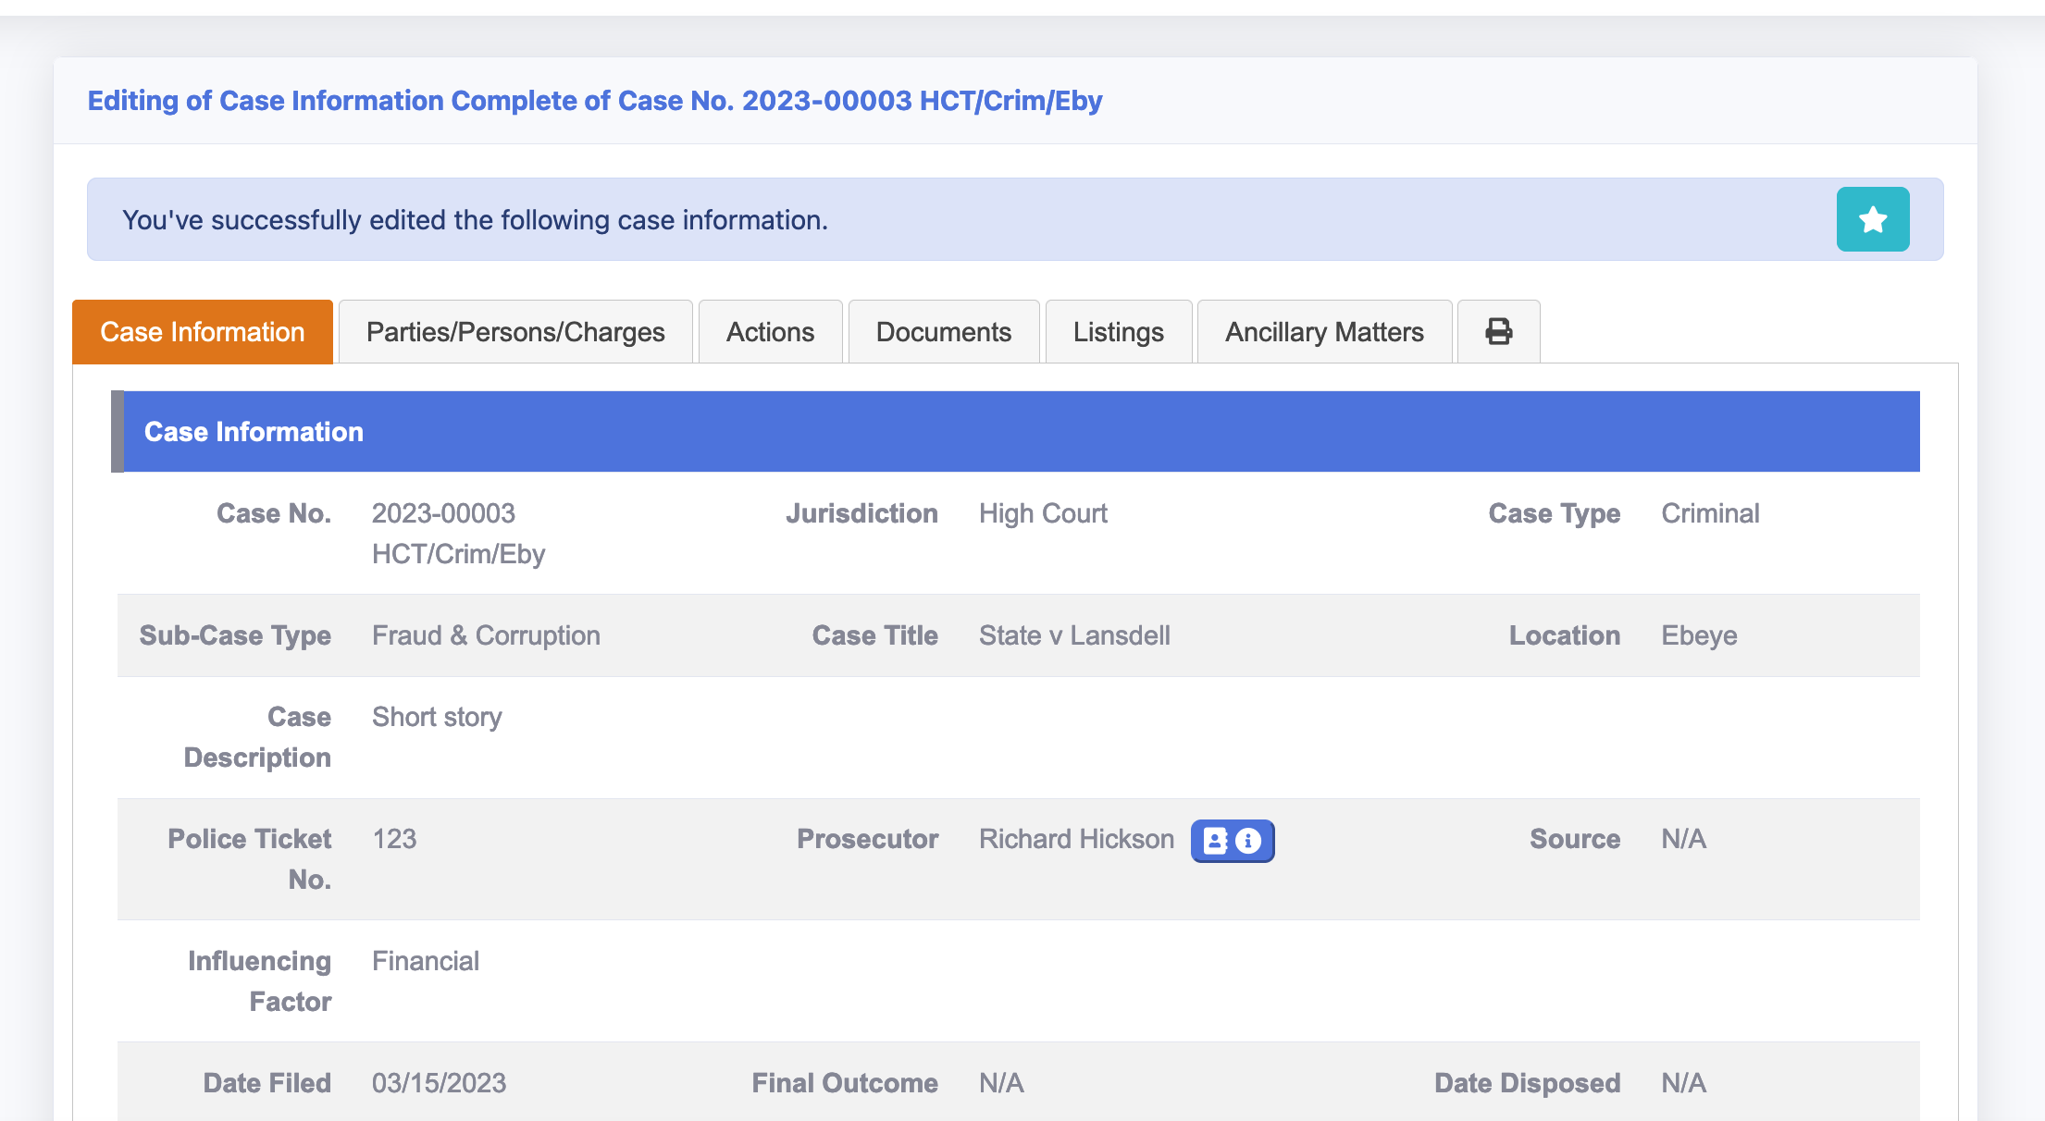
Sub case type example

Slide 16
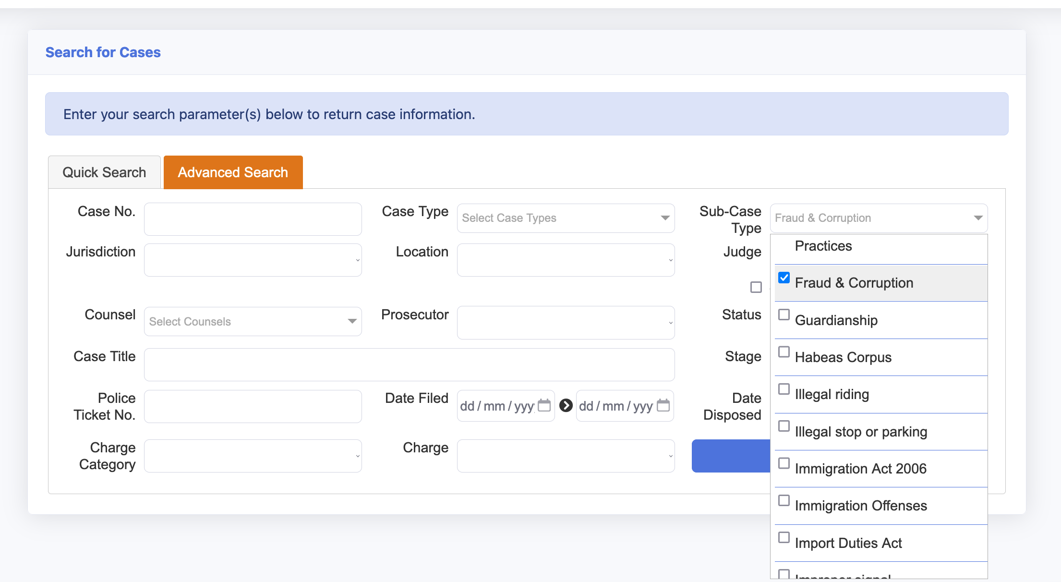
Sub case type searching

Slide 17

Data Quality
How to ensure quality?
  Personal ownership
  Independent ‘checker’
  Peer review
  Automated reporting
  OR?

Slide 18

Data Reporting
Unless your system has pre-defined reports, then the production & transformation of raw data into a report typically requires MS XLS skills
Explore options and techniques to present the data clearly
Grouping the charges ready for analysis
  Use of Pivot tables (e.g. Vanuatu and RMI example)

Slide 19
Data Analysis
Now you have turned the data into information, now to find the gold
And to be able to interpret, analyse and comment on the information
Being able to ‘tell a story’ is key

Slide 20
Categorising the charges

Slide 21
Easily seeing the results

Slide 22
Key Indicators to measure
How many - cases and/or offences
How long - for the case itself
What outcomes - guilty/not guilty
What orders - imprisonment, fine
How old - days pending
How complex - proxy is attendance/continuance rate
What other factors do we want to measure?

Slide 23

Vanuatu experience

Slide 24

Data capture
All case details, parties, listings and chargers are entered into the system.
Using standard naming convention for case description and must have date of registration
Identify case type, case stage and assigning a judicial officer
Scanning documents and uploading it into the system

Slide 25
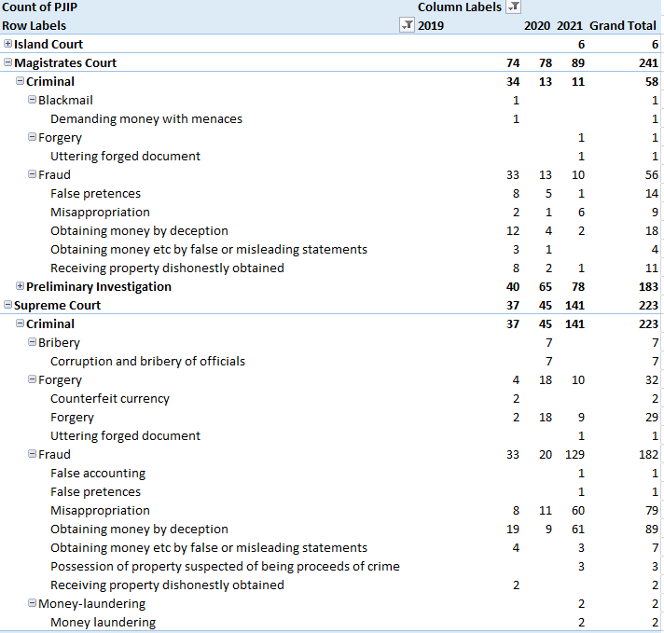
Charge analysis

Slide 26

Data Quality
Secretaries must update and upload relevant documents
Update charge outcomes and orders
Putting a finalized dated
The CR then checks and makes sure the case is updated and completes the case file in the system

Slide 27
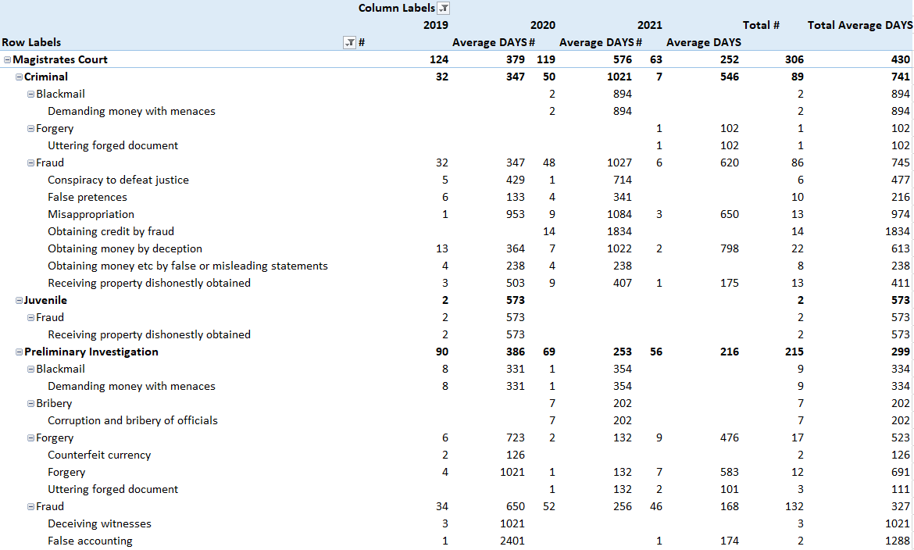
Fraud and Corruption performance

Slide 28

Data Analysis
Export data from System & analyse raw data to identify the quality of the data e.g. missing case stage, missing charges, following the 3 C’s rule ( Correct, Consistent and Completed)
Meetings with the secretaries are held when the need arises with the quality of the data entered
Run a regular refresher training and remind court secretaries the importance of data consistency of offences and the charge orders and outcome

Slide 29

Marshall Islands experience

Slide 30
Documents

Slide 31
Document Capabilities
Complex cases require advanced document capabilities:
  Searching (often referred to as Full Text Searching)
  Annotating (making notes electronically)
  Tagging (like the ‘stickers’ we use)
Many systems have basic capabilities, but consideration should be given to linking to specialist document facilities if not readily available

Slide 32
Document Capabilities
Preparation of material from the parties:
  Encouraging Prosecution (or demanding) them to use such tools as e-Brief
  Brief of Evidence generated from system
Examples include CTS, eBrief, Synergy and Lexis Nexis

Slide 33
Vanuatu experience

Slide 34

Managing Documents
All documents are scanned after registration and added to the case file
Accept documents via email can be dragged and dropped into the case file

Slide 35
Managing Documents
We are trying to ensure that all physical documents match up with electronic scanned documents but judicial officers not interacting with the electronic file and still prefer the physical files
  Need full text searching capability
  Need alert to inform Judge of new documents

Slide 36
Marshall Islands experience

Slide 37
Active Case Management

Slide 38

Active Case Management
Tracking or Management systems to provide:
  Judicial officers’ easy way to see/track their ‘favourite’ cases
  Allow for managing case by stage, or by task – with alerts
  Easy navigation to documents
    Advanced documents facility where required
  Cases can be assigned to one or more judicial officers including registrars

Slide 39

Active case management
Tracking or Management systems to provide:
  Tracking ‘applications’ within a case e.g. Bail or Pre-Trial Challenges
  Tracking related cases
  Tasking/actions on a case
  Ability to find applicable cases easily either by specific charge or sub-case type

Slide 40
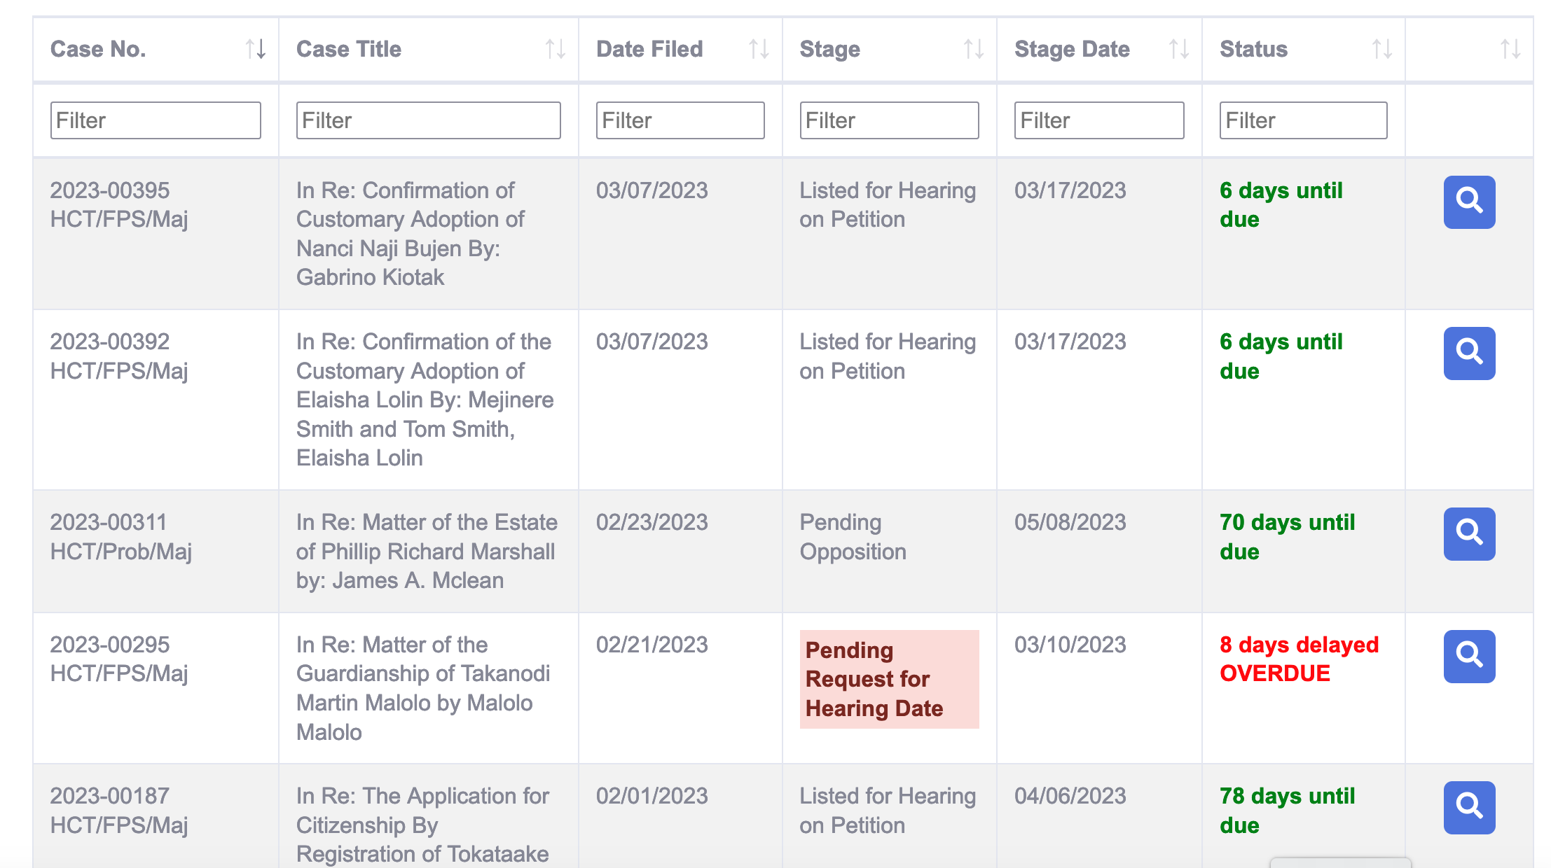
Judicial interface for Active Case Management

Slide 41
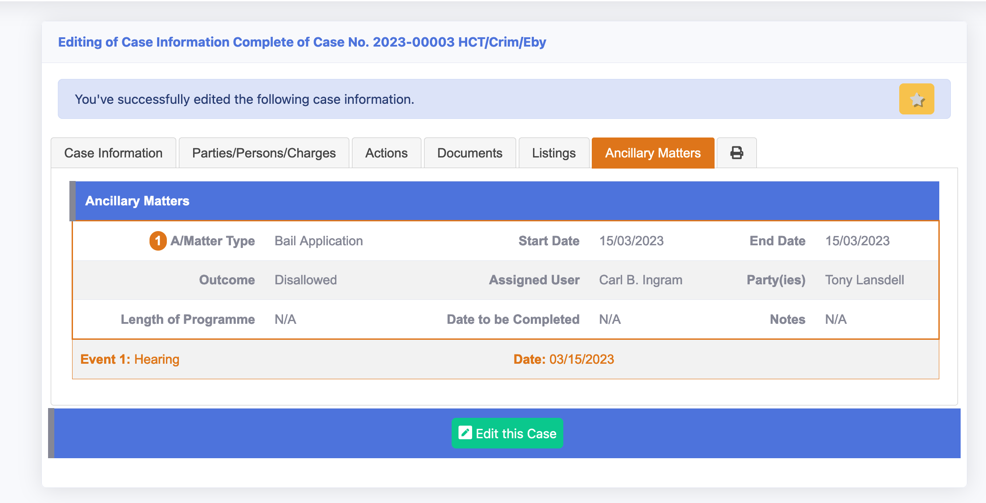
Additional applications on a case

Slide 42
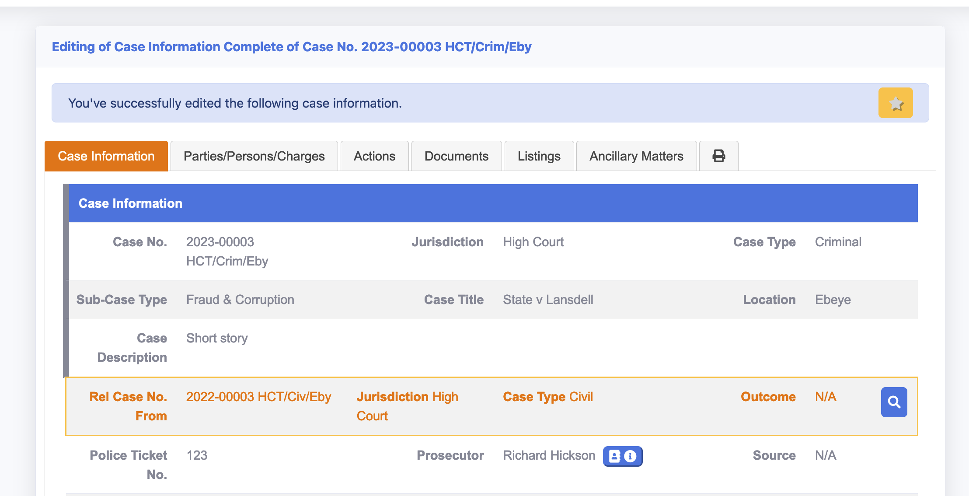
Related Cases

Slide 43
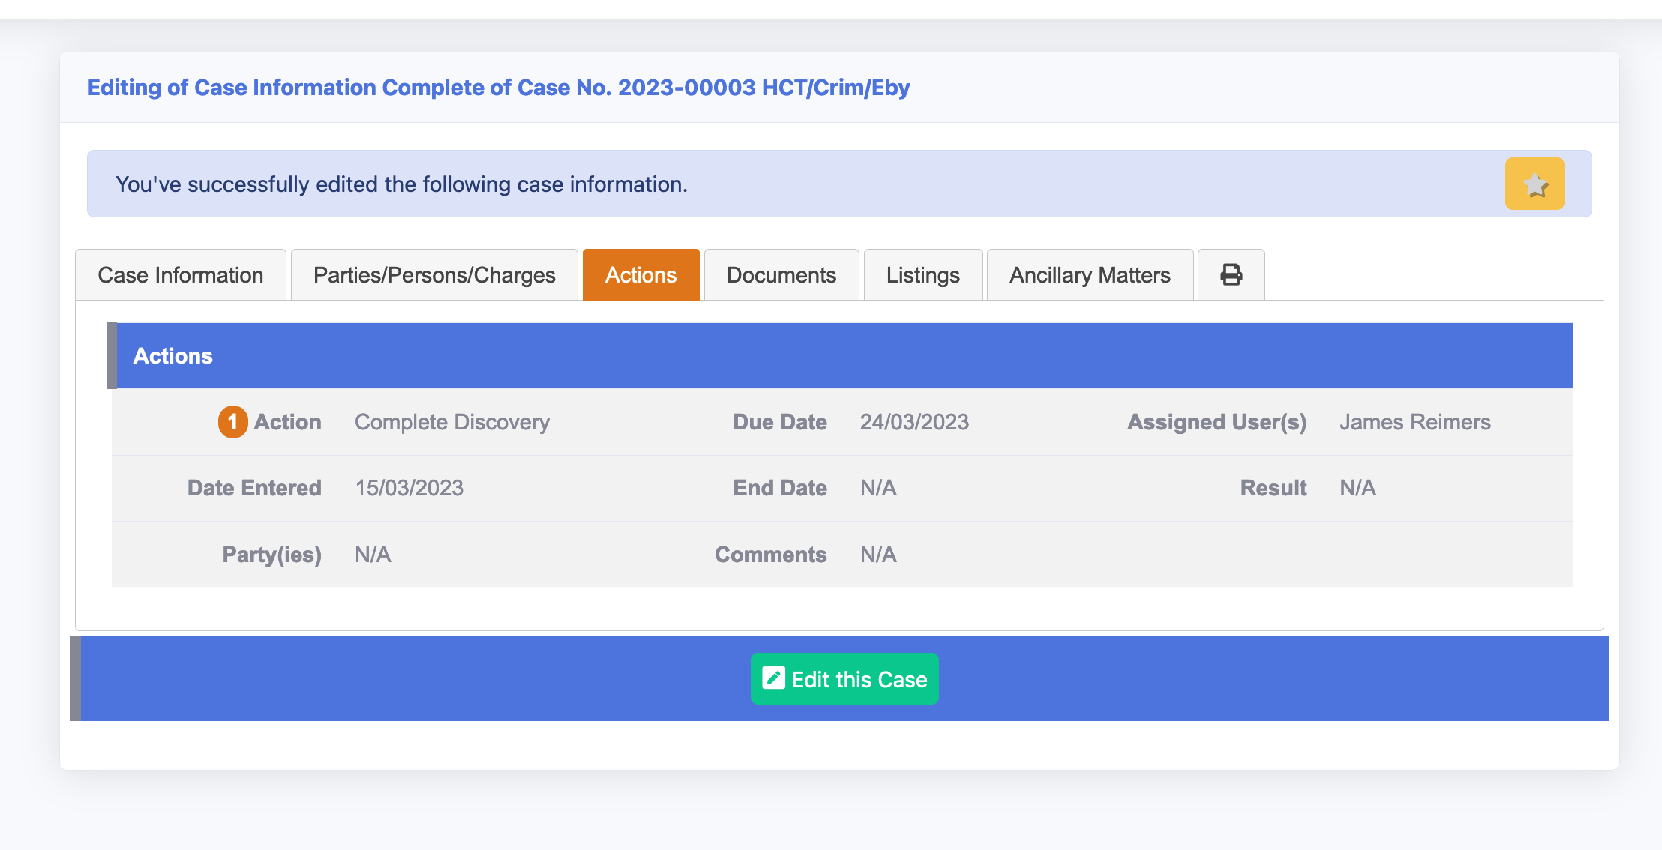
Tasking or Actions on a case

Slide 44
Vanuatu experience

Slide 45
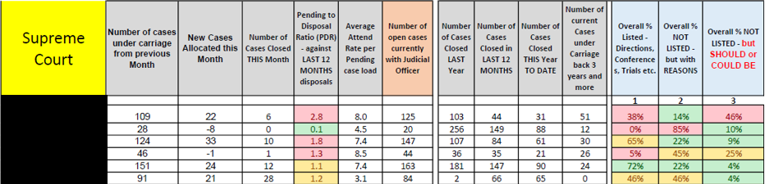
Vanuatu - Active Case Management
Still something we are working on but we do have a Judge using the system to manage their future listings
Produce Monthly Tracker Report
This is an example of a Monthly Judicial Tracking report submitted to the Judges. It shows % of their pending workload – future listed or not

Slide 46
Marshall Islands experience

Slide 47

Summary
Getting the data right, and able to analyse it
Managing the documents and using the documents
Managing the case – active case management

Slide 48

Questions

Slide 49

Group 1: Data Gathering Questions
Do your systems capture the level of detail required?
How do you ensure data quality of the information captured?
How well are you able to report on the information required to understand the workload and performance of Fraud and Corruption cases?

Slide 50
Group 2: Document Handling Questions
How well placed might your jurisdiction being to having an electronic court file?
What challenges are there in creating such?
How well placed are your prosecution and other major offices to prepare/submit documents electronically?
Would the judiciary embrace such a concept?

Slide 51
Group 3: Active Case Management Questions
How well placed are your systems to enable judges to actively case manage their cases?
What challenges are there in having judges use the system to manage their cases?

Slide 52

Action Planning
Throughout the duration of the Online Course we have been discussing ideas and suggestions that may be of interest to your Court.
Please spend some time with your colleagues to consider any key actions that you may wish to consider implementing in your Court.
  What needs actioning
  By when, and with what milestones
  With what resources
  Who needs to be involved

Slide 53
Thank you

