Slide 1
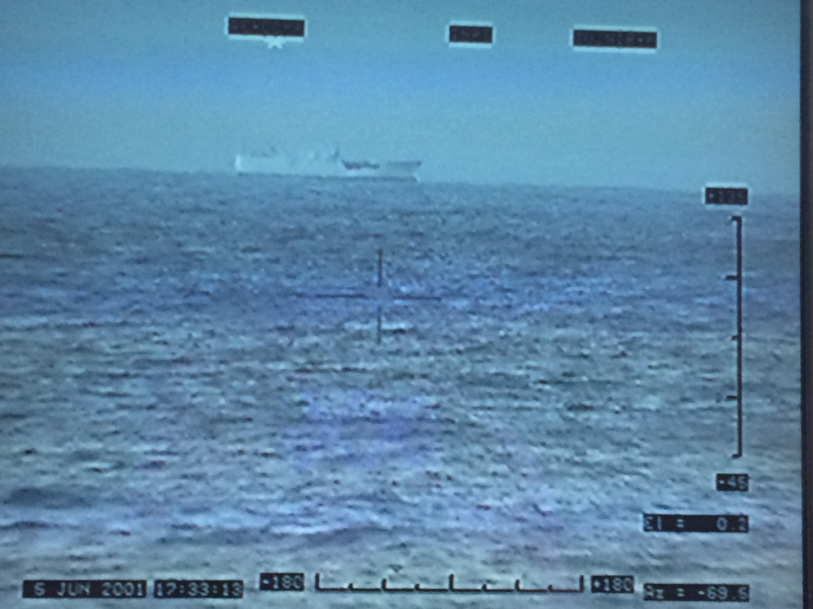
Admiralty Court
Maritime Law Enforcement and High Sea Challenges
NSW Police Inspector Joe McNulty
Admiralty Court Sydney

Slide 2
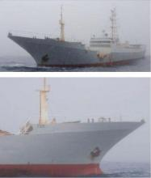
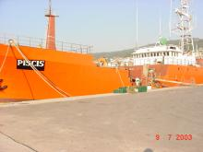
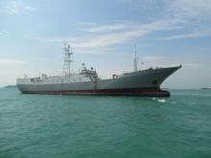
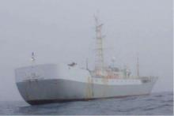
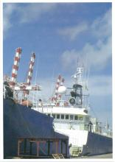
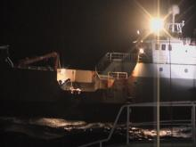
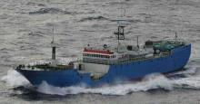
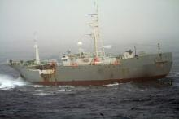
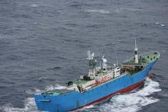
Global Maritime Law Enforcement
Environmental Crime Challenges

Slide 3
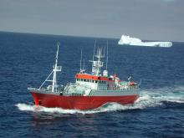
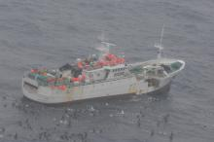
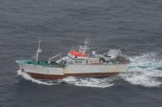
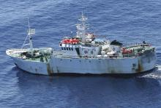
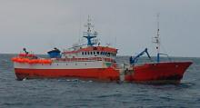
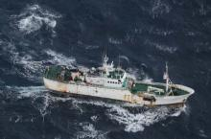
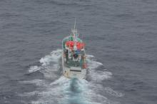
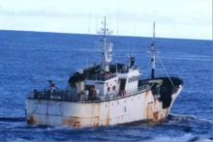
IUU Fishing Vessels
‘Sima Qian Baru 22’
Korea, South
“Dorito”
Uruguay
“Huang He 22”
Tanzania
“Corvus”
Panama
“Thule”
Equatorial Guinea
“Chang Bai’
Stateless
“Kunlun” Equatorial Guinea
“Galaxy”
Panama

Slide 4
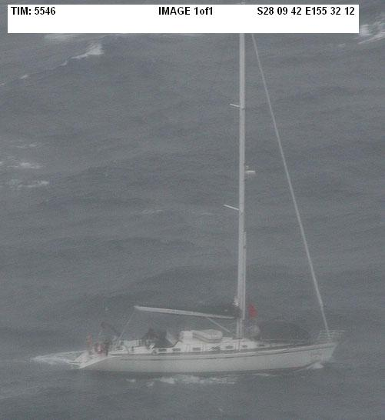
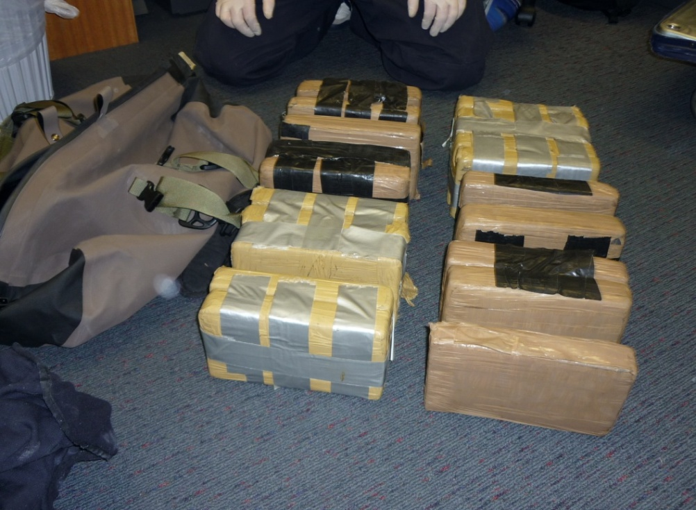
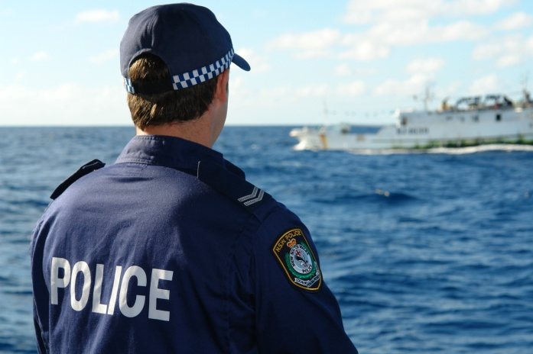
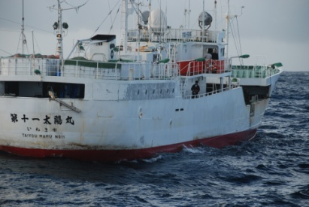
Cocaine Seizures.
2007 to 2010 European Maritime Analysis on 40 operations at sea. The maritime ops seized a total of 52,3 tons of cocaine.
62.5% of all detections were on yachts vs 20% on fishing vessels.
44% of cocaine quantity were on fishing vessels vs 27% on yachts.

Slide 5
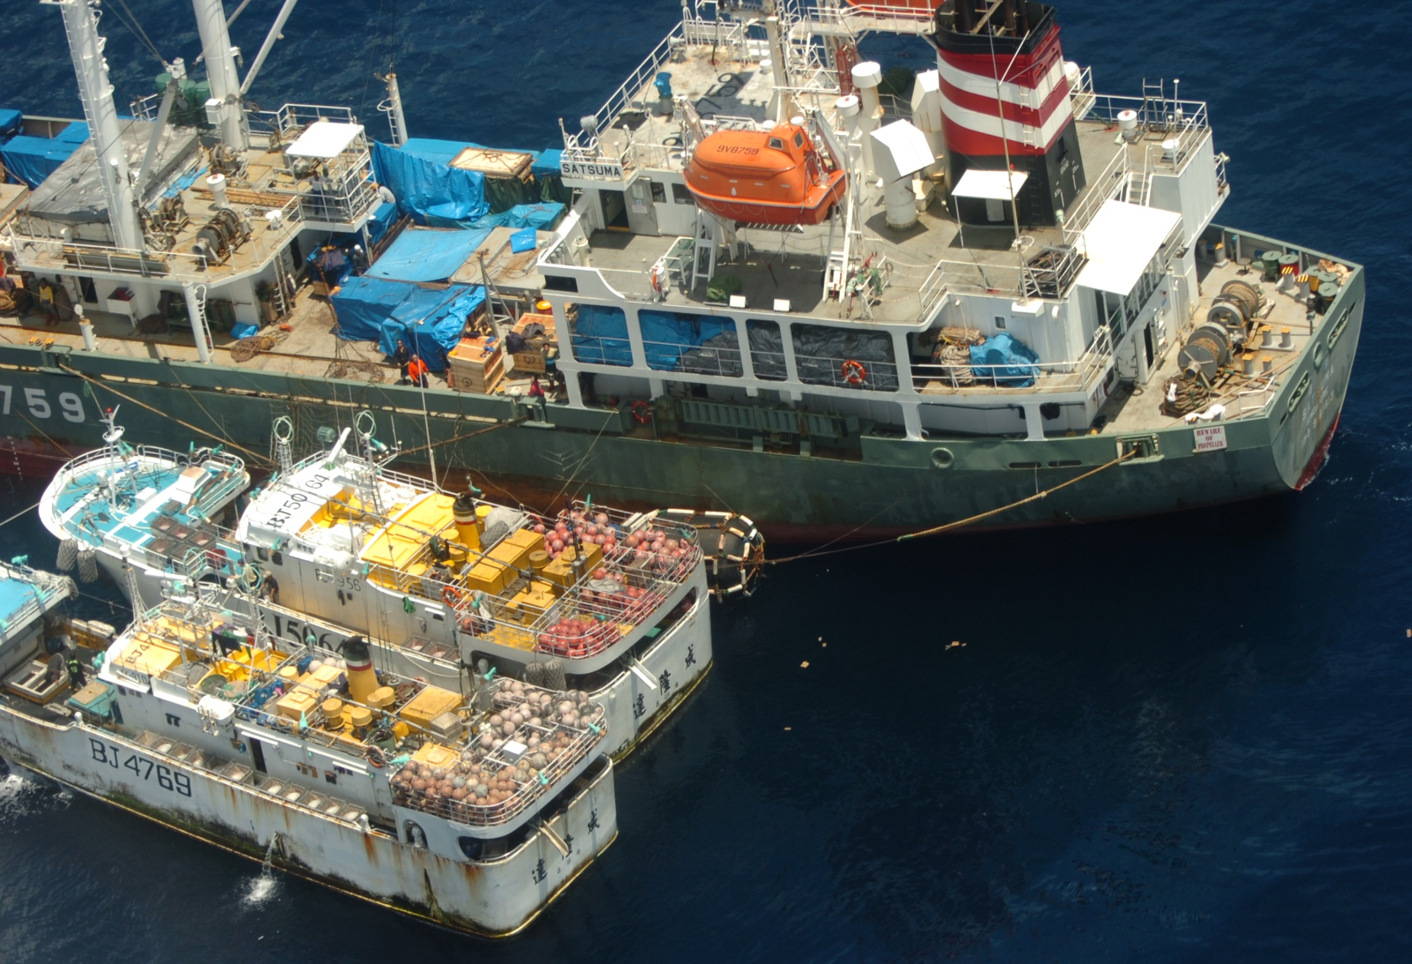
Transhipments at sea
Transfer of illegal fish catches.
Movement of narcotics,
Transfer of weapons and firearms,
Money Laundering.
People smuggling (Crew, women and children, asylum seekers)
Black market commodities
Fuel and Oil products (West Africa)
Exportation of illegal wildlife (rhino and elephant –East Africa)

Slide 6
Transnational crime cycle of fishing vessels
Flag State of Vessel
Nationality of Vessel's Master
Vessel Owner
Multi National Crew
Multi Jurisdictional operations

Slide 7
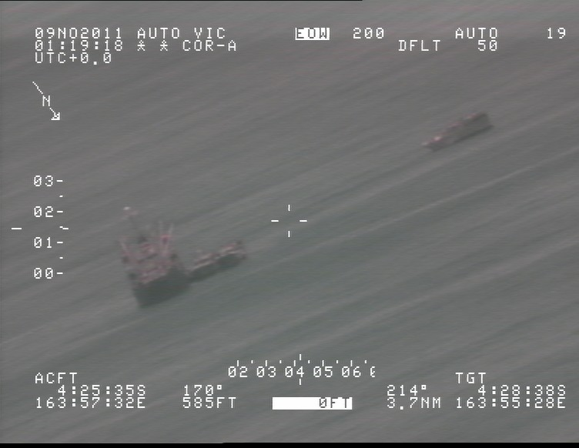
Organised Crime: Maritime model
Organised Crime
Fishing Vessel Operations
Company and Ownership Structure
Other Crime Areas
Nationality of Master
Nationalities of Crew
Tax Havens and relationships with Flag States
Area of Operations
High Seas Maritme Zones
Type of organised criminal activity
Flag State
Capacity, or ability or willingness to enforce jurisdiction
Capability of law enforcement to respond and Investigate
Responsible Jurisdiction
Ports of convenience

Slide 8
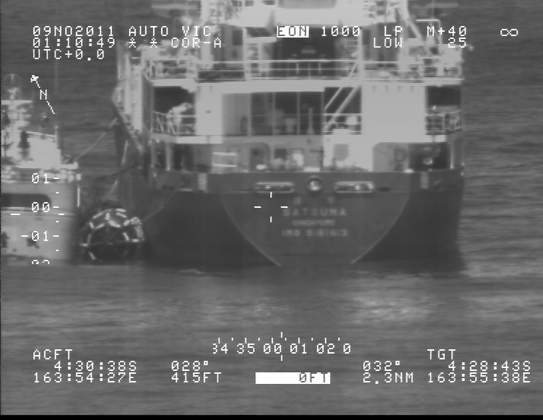
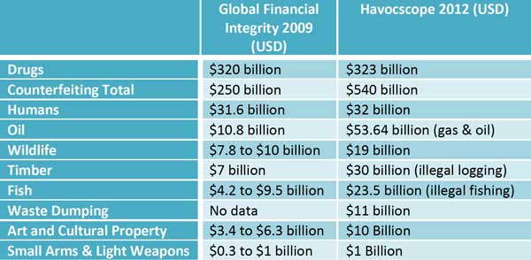
Organised Transhipment Operations

Slide 9
Loss of Fisheries revenue, reduced GDP.
Reduced food availability, increases local costs
Civil unrest, instability, increases in anti-social community behavior
Regional Instability & Organised Crime entry
Pacific Ocean overfished & depleted Fish stocks
Increase of Australian & N.Z foreign aid
Increase of foreign fishing vessels in South West Pacific
Increase of Maritime Security risks and enforcement costs

Slide 10
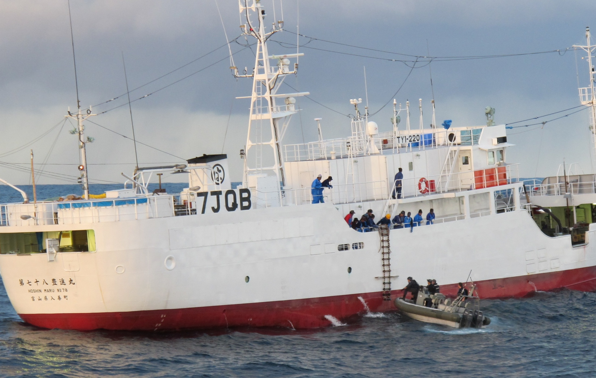
Summary

