Slide 1



Managing and Reporting on Fraud and Corruption Cases Online Course
Via Zoom 20 & 27 July and 3 & 10 August 2023

Slide 2

Session 3 - Agenda
Welcome & Introduction (10 minutes)
Presentation on Procedural Steps and Documents (30 minutes)
Discussion Questions (30 minutes)
Introduction to next week’s session (10 minutes)
Session Wrap-Up (5 minutes)

Slide 3
Managing and Reporting on Fraud and Corruption Cases Online Course
Session 3: Procedural Steps and Documents
Presenters: Judicial Registrar Jodie Burns, Federal Court of Australia
Assistant Registrar Victoria Belo, National Court of Papua New Guinea

Slide 4
Procedural steps and documents
Overview of commonalities in process
Charges, indictments/charge sheet and particularising fraud, bribery and other corruption offences

Slide 5
Procedural Fairness
Judicial Registrar Jodie Burns,
Federal Court of Australia

Slide 6
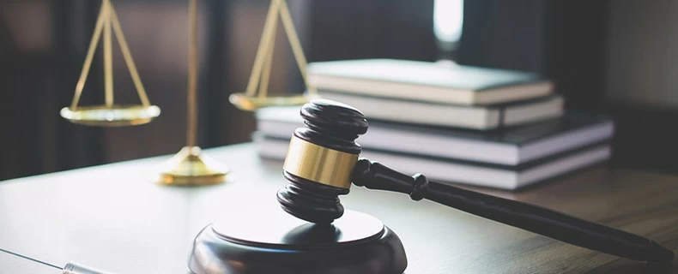
Procedural Fairness
principle that runs through everything that happens in both criminal and civil law
used interchangeably with the term ‘natural justice’
requires that all times participants in the legal system have a right to a fair and just trial
means fair and just principles are applied to all decision making and court procedures
often appeals to higher courts are on the basis of a denial of procedural fairness.

Slide 7
Procedural Fairness - Case Law
The common law in Australia recognises a duty to accord a person procedural fairness or natural justice when a decision is made that affects a person’s rights, interests or legitimate expectations.

Slide 8

Kioa v West (1985) 159 CLR 550
FACTS: Mr Kioa travelled to Australia from Tonga in 1981 for a short study course. Mr Kioa’s wife and daughter followed him to Australia.
After 3 months, Mr Kioa resigned from his job in Tonga and he stayed in Australia without a visa.
Soon after, a massive cyclone devastated Tonga. Mr Kioa continued working in Australia and sent money home to his relatives in Tonga. He and his wife had another baby, who then had Australian citizenship.
Immigration officials caught up with Mr Kioa and he was arrested. After his arrest, Mr Kioa applied for a new visa.
The immigration officials report included the following statement:
Mr Kioa’s alleged concern for other Tongan illegal immigrants in Australia and his active involvement with other persons who are seeking to circumvent Australia’s immigration laws must be a source of concern.
Mr Kioa was not given an opportunity to respond to the immigration official’s statement.

Slide 9
Kioa v West (1985) 159 CLR 550
Justice Mason (as he then was) at p 550 said:
“It is a fundamental rule of the common law doctrine of natural justice expressed in traditional terms that, generally speaking, when an order is made which will deprive a person of some right or interest or the legitimate expectation of a benefit, he is entitled to know the case sought to be made against him and to be given an opportunity of replying to it… The critical question in most cases is not whether the principles of natural justice apply. It is: what does the duty to act fairly require in the circumstances of the particular case?”
Notes:
F

Slide 10
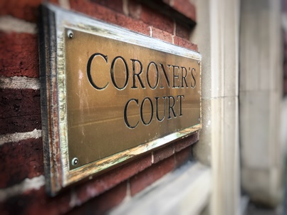
Annetts v McCann (1990)
170 CLR 596
FACTS: a case involving the right of two parents to make submissions at a coronial inquiry into the deaths of their two sons
Mason CJ, Deane and McHugh JJ noted the continued evolution of the concept of procedural fairness: ‘many interests are now protected by the rules of natural justice which less than 30 years ago would not have fallen within the scope of that doctrine’s protection’.
more recently been said that the common law doctrine has a ‘wide application and is presumed by the courts to apply to the exercise of virtually all statutory powers’.

Slide 11
Annetts v McCann (1990)
170 CLR 596
Chief Justice Mason and Justices Deane and McHugh in High Court at p 598 said:
“It can now be taken as settled that, when a statute confers power upon a public official to destroy, defeat or prejudice a person's rights, interests or legitimate expectations, the rules of natural justice regulate the exercise of that power unless they are excluded by plain words of necessary intendment.”

Slide 12
International Finance Trust Company Ltd v New South Wales Crimes Commission (2009) 240 CLR 319
Chief Justice French (as he then was) in the High Court of Australia said:
“Procedural fairness or natural justice lies at the heart of the judicial function… It requires that a court be and appear to be impartial, and provide each party to the proceedings before it with an opportunity to be heard, to advance its own case and to answer, by evidence and argument, the case put against it...”

Slide 13

Procedural fairness requires that:
  a decision-maker is impartial, and free from actual or apparent bias (the bias rule),
  a person whose interests will be affected by a proposed decision receives a fair hearing, including the opportunity to respond to any adverse material that could influence the decision (the hearing rule), and
  findings are based on evidence that is relevant and logically capable of supporting the findings made (the evidence rule).

Slide 14
Procedural fairness
In the current context, procedural fairness requires that a person brought before a court for a fraud, bribery or other corruption offence is given a reasonable opportunity,
not a perfect opportunity, to put forward their case.
Notes:
What does procedural fairness look like for a person brought before a court for a fraud, bribery or other corruption offence?
Examples
The indictment is sufficient particularised – what does that mean ?
The brief of evidence is served on each accused with enough time to obtain legal advice and consider their defence.
All witness evidence in approved format (e.g. affidavit / statement format)
Each accused is advised of all potential witnesses.
Each accused is provided with a list of any other potentially relevant information that is not included in the brief of evidence.

Slide 15

What does procedural fairness look like for a person brought before a court for a fraud, bribery or other corruption offence?
  The indictment (charge sheet) is sufficient particularised – what does that mean ?
  The brief of evidence is served on each accused with enough time to obtain legal advice and consider their defence.
  All witness evidence in approved format (e.g. affidavit /statement format)

Slide 16
What does procedural fairness look like for a person brought before a court for a fraud, bribery or other corruption offence?
  Each accused is advised of all potential witnesses.
  Each accused is provided with a list of any other potentially relevant information that is not included in the brief of evidence.

Slide 17
Procedural Fairness
is to be determined by
an objective standard
i.e. what a reasonable person would believe was a reasonable opportunity in the circumstances
is also known as ‘Natural Justice’ and both terms are often used interchangeably

Slide 18

Bias Rule
  A decision-maker, such as a judge, is to be impartial, and free from actual or apparent bias. They should not:
    have a close personal or family relationship with any parties who have an interest in the outcome.
    have a direct or indirect financial or other interest in the outcome of the decision.
    be a person with a closed mind or pre-conceived ideas about the outcome.

Slide 19
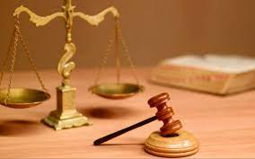
Hearing Rule
  A person whose interests affected by a proposed decision is to be given a fair hearing, including being provided with:
    reasonable notice of the case to be met, including sufficient information (e.g. particulars of each charge) about the matter to be decided.
    reasonable time to prepare and the opportunity to respond, including calling any relevant evidence in relation to any adverse material that could influence the decision.
    the opportunity to appeal the decision that has been made.

Slide 20
Evidence Rule
  All evidence is relevant and logical.
  Findings / decisions are based on evidence that is relevant and logically capable of supporting the findings / decision made.

Slide 21

The role Court Officers play to ensure procedural fairness
  must understand they also have an important obligation to ensure that procedural fairness is afforded to all trial participants.
  creates a tension in the reconciliation of the Court’s duties because it is not the function of the Court to give legal advice to, or conduct the case on behalf of a party, even if one or both parties are unrepresented.

Slide 22
The role Court Officers play to ensure procedural fairness
  The Trial Judge, the Court Officers and other relevant Court staff are required to put a party in the position of being able to make an effective and informed choice.
  What will constitute a reasonable opportunity for a party to present his or her case in a given situation depends upon the whole of the circumstances, including the nature of the jurisdiction exercised and the statutory provisions governing its exercise.

Slide 23

Self-represented litigants
  Well established that a Court has an obligation to take appropriate steps to ensure that an unrepresented litigant has sufficient information about the practice and procedure of the Court
  Think about what your Court offers self-represented litigants and ask yourself whether you think it is sufficient.

Slide 24

Papua New Guinea Fraud Track
Assistant Registrar Victoria Belo,
National Court of Papua New Guinea

Slide 25

Fraud Track
The Fraud & Corruption Offences Track (FCOT) is a special Court Track of the National Court Crimes Division, established under the Fraud & Corruption Related Offences Rules 2013
FCC cases are defined in the Criminal Code, under the Schedule to the Rules which are managed by a Judge Administrator assigned to this tracks.
Civil proceedings commenced under the Proceeds of Crime Act (POCA) and Mutual Assistance in Criminal Matters Act also form part of the Judge Administrator’s responsibility.

Slide 26

Fraud & Corruption Offence Rules
Fraud and Corruption procedures were governed by the Criminal Practice Rules 1987
For the purpose of facilitating a quick, fair and efficient disposition of Fraud and Corruption cases a Fraud and Corruption Practice Rules 2013 was adopted.

Slide 27
Case Registrations
Registration of Fraud cases in the National Court:
Committal from the Committal/District Courts
Applications (Special Provisions in Relation to Proceedings under the Proceeds of Crime Act and the Mutual Assistance in Criminal Matters Act.
Interlocutory Applications

Slide 28
Files & References
Register case in Case Docketing System (CDS) and allocate to Tracks and Judges
After case number is generated by CDS, create manual file for that case
Create File Index
Number Committal Court depositions
Create case file cover sheet
Scan filed documents
Vetting of documents
Upload scanned documents in CDS
Create Court Lists in CDS & Manual

Slide 30

Conclusion
Introduction of Fraud and Corruption Practice Rule 2013
improved the management of fraud and corruption cases
File Indexing
Assist identify court documents
Reduced instances of misleading by parties
Case File Cover sheet
Assist Judges to quickly reference documents

Slide 31

Key Messages
  Procedural fairness requires that a Court give all parties a reasonable opportunity to present evidence and to make submissions in support of his or her case.
  If required, a Court has an obligation to explain any relevant processes and procedures to parties.

Slide 32
Key Messages
  3. A Court should ensure that information, documents and submissions received from parties is accurately stored on the Court file.
  4. A Court should develop, where required, forms, practice notes and templates for correspondence with parties to ensure that information about the Court’s process is clear and consistent.
  5. Implement a process for self-represented litigants.

Slide 33

Questions

Slide 34
Discussion Questions
You will be placed into a breakout group for 10 minutes to discuss these questions. Please appoint a spokesperson to report back on behalf of the group.
Consider how your court treats self-represented litigants. How is procedural fairness afforded to them? Does this differ from how a person is treated when they are represented by counsel?
Consider fraud and corruption cases that may come before your court. What considerations are relevant to ensure procedural fairness is afforded to those charged with such offences?
Have you been involved in a trial where the judicial officer has recused themself or been asked to recuse themself from a case because of bias? What were the circumstances? What was the outcome? Did the judicial officer hear the case?
Notes:
At the end of session 5 – Jodie Burns to hand out case scenario for sessions 6 and 7.

Slide 35
Action Plan
Throughout the duration of the Online Course we will be discussing ideas and suggestions that may be of interest to your Court.
Over the next week, please meet with your colleagues and consider any key procedural steps and document actions that you may wish to consider implementing in your Court.

Slide 36

Next Week: Session 4 -
Case Management
Thursday 10 August 2023
12-2pm (GMT+10:00)
Use same Zoom link
Presenters: Shemi Joel, Ingrid Kabua & Tony Lansdell
Action plan; one key take away
Post-Course Survey

Slide 37
Due to varying locations, local time zones for
Session 4 are as follows:
Thursday 10 August, 2023
11:00am | Palau
12:00pm | Australia Papua New Guinea
1:00pm | Federated States of Micronesia Solomon Islands Vanuatu
2:00pm | Fiji Kiribati Nauru Republic of Marshall Islands
3:00pm | Tonga Samoa Tokelau

Slide 38
See you next week!

