Slide 1



Judicial Officers’
Fraud and Corruption Online Course
Via Zoom - 18, 25 & 31 May, 8 & 15 June 2023

Slide 2
Session 4: Trial Management
Thursday 8 June, 2023
Honourable Chief Judge Brian Devereaux SC
Honourable Judge Brad Farr SC
District Court of Queensland

Slide 3

Session 4: Trial Management
Welcome & Introduction (5 minutes)
Chief Judge Devereaux & Judge Farr’s presentation (30 minutes)
Questions & Answers on presentation (30 minutes)
Discussion Questions on Trial Management (30 minutes)
Introduction to next week’s session & scenario (5 minutes)
Session Wrap-Up (5 minutes)

Slide 4

Fraud/Corruption Trials
Can be difficult legally
Voluminous in documentary evidence content
Complicated factually and lengthy

Slide 5

Trial Management
By the trial judge,
Both pre-trial and during the trial
Can be of considerable benefit and of particular importance

Slide 6

Why is Trial management important?
The running trial by counsel
The time the trial takes
The way documentary evidence is presented
The early resolution of disputes of law
The jury’s early understanding of the issues and of the relevant law and
The fairness of the trial.

Slide 7
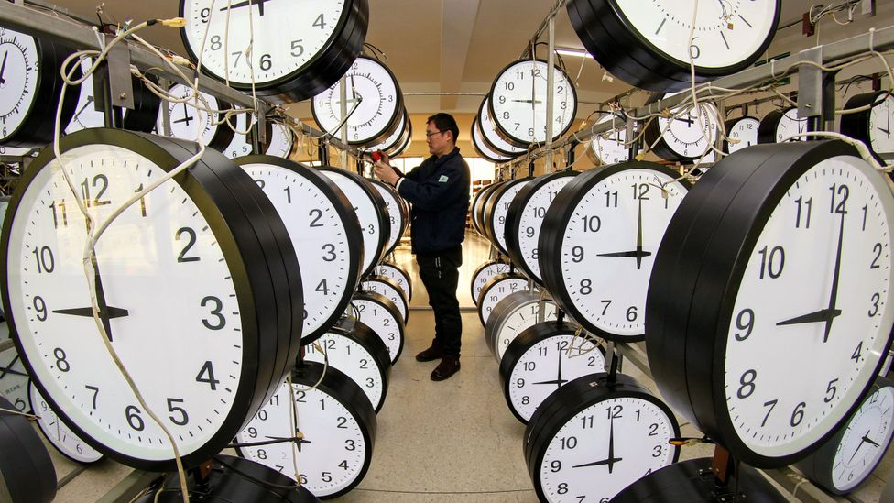
The longer the trial is expected to take
More important pre-trial management is because at this stage the Court has the greatest ability to play an appropriate part in the way in which the trial will proceed.

Slide 8
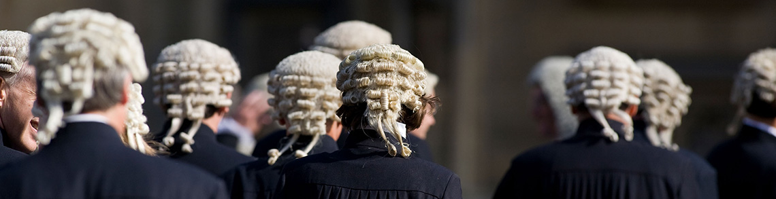
Lawyers don’t look forward to these trials
Why?
What does this lead to?
Notes:
Leads to last minute, applications, preparations, turning their minds to the state of the evidence, assessing the strength of their case & tactics and approach they will adopt & whether the matter should be a trial at all.

Slide 9

Qld District Court approach:
Proactive role in pre-trial management
Holding mentions or pre-trial reviews on a reasonably regular basis
There are a range of issues addressed

Slide 10
Mentions & Trial Reviews
First mention at presentation of the indictment to the Court
The parties won’t be able to inform the Court as to the way in which the matter will be dealt with – particularly so for long, complicated matters

Slide 11
First Mention
Most matters adjourned for at least a month enable the lawyers to do what is needed
Complicated matters for longer
Length of adjournment will depend on nature and the complexity of the matter

Slide 12

Keep pressure on parties at Mentions
How?
Set pre-trial hearing dates –why?
Verbal criticism – why?
Set a trial date – why?
Frequent mentions – why?

Slide 13

Ask the Parties
To identify the issues that will be in contest – whether they are issues of law or fact.

Slide 14
Why?
Focus counsel’s mind on what is important
Helps identify issues will require pre-trial ruling
Helps identify prosecution witnesses required to give evidence

Slide 15
Why?
Helps identify exhibits need to be tendered during the trial and through which witness or witnesses
Helps parties determine if admissions can be made re non-controversial areas

Slide 16

Remember
Defence not obliged to reveal the defendant’s case
Doesn’t prevent the defence and prosecution lawyers working to ensure the Court’s time is not wasted on irrelevant or uncontested matters
How to promote this process?

Slide 17

Can help defence & prosecution?
Only if provided in conjunction with the particulars of the charges
How to promote this process?

Slide 18
Particulars
s.573 of the Criminal Code (Qld)
Court may direct particulars be delivered to the accused on any matter alleged in the indictment
May adjourn the trial for the purpose of such delivery.

Slide 19
Why are Particulars important?
Questions of inadmissibility of evidence due to irrelevance
Necessary to enable the defence to make particular forensic judgements – Examples?

Slide 20
Particulars
Must be read with the terms of the indictment in defining the terms of the charge and the case which the Crown has to prove.
Early provision of particulars is important – why?

Slide 21

Checklist of issues to be addressed during pre-trial
Require the prosecution:
To provide a time schedule for the witnesses it intends to call – why?
Place on the record all witnesses have been contacted/subpoenaed & advised of the likely date they are available and will give evidence – why?

Slide 22
Checklist of issues to be addressed during pre-trial
Require prosecution to identify if any evidentiary aides to be used i.e. graphs, tables, videos – why?
For large number of documentary exhibits clarify whether the prosecution will have exhibit books prepared in advance for each juror – why?
Could the trial be conducted by e-trial – why?

Slide 23
Checklist of issues to be addressed during pre-trial
How will each document be treated when tendered – why?
Will the jury be provided with transcript of evidence when they retire – why important?
Are any admissions to be made during the trial – importance?

Slide 24
Checklist of issues to be addressed during pre-trial
Require prosecution to identify witnesses it will seek leave to call remotely i.e. via video or audio-link
Require the defendant to identify any objections they have

Slide 25
Checklist of issues to be addressed during pre-trial
Court should ensure equipment working properly
Factor in holiday periods when listing
Number of reserve jurors to be empanelled- registry should question on availability for long trial

Slide 26
Checklist of issues to be addressed during pre-trial
Will you sit five days a week for long trials – why?
Four days or 4.5 may be better
Helpful for jurors if after the prosecutor’s opening address, defence counsel gives a brief opening statement – why?

Slide 27
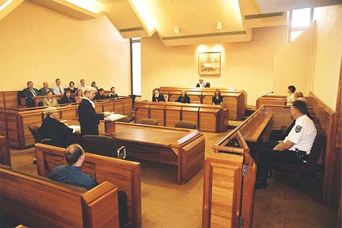
Commencement of Trial
Reiterate to jury estimated length of trial
After empanelment advise jury of sitting dates
Inform jury of aids including transcript
Advise jury not to worry if can’t understand nature of case and issues initially

Slide 28
During Trial
Start working on your summing-up from the very beginning of the trial - advantages of doing this?
Make succinct notes at end of each day
Use notes in summing up
Make notes of exhibits of particular relevance

Slide 29
During Trial
Provide a copy of your summing-up to counsel before delivering to jury – why?
Use counsel to assist the trial process by asking them to assist the Court – examples?

Slide 30
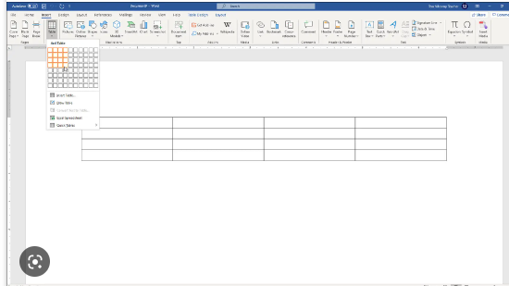
Multiple Accused
Ask counsel to provide a table showing the evidence that only relates to one or some of the defendants and the identity of the defendant(s)

Slide 31

Self-represented defendants
Not uncommon in fraud/corruption cases
Adds to the judicial burden of presiding over the trial plus sometimes substantially, to the length of the trial
Queensland approach?

Slide 32
Self-represented defendants
Pay attention to the way the defendant conducts himself/herself - why?
The manner of questions asked by the defendant – why?
Whether the defendant has complied with the rule in Browne v Dunn
Issues in contest and may need to frequently remind the defendant of those
Conduct of the trial by the prosecutor – why?

Slide 33
Self-represented Defendants
Remain calm and detached
Engage with them as little as possible!

Slide 34

Questions

Slide 35
Session 4: Trial Management Discussion
Breakout room discussions

Slide 36

Next Week: Session 5 - Evidence
Thursday 15 June
12-2pm (GMT + 10:00)
New Zoom link to be sent
Session 5 Evidence Case Scenario that will be emailed to you
Come to session ready to discuss
Judicial Facilitator: Chief Judge Devereaux / Judge Farr

Slide 37
Due to varying locations, local time zones for the discussion are as follows:
Thursday 15 June, 2023
11:00am | Koror, Palau
12:00pm | Brisbane, Australia Port Moresby, Papua New Guinea
1:00pm | Pohnpei, Federated States of Micronesia Honiara, Solomon Islands Port Vila, Vanuatu
2:00pm | Suva, Fiji Tarawa, Kiribati Yaren, Nauru Majuro, Republic of Marshall Islands
3:00pm | Nukualofa, Tonga Apia, Samoa Nukunonu, Tokelau

Slide 38
See you next week!

