Slide 1



Judicial Officers’
Fraud and Corruption Online Course
Via Zoom - 18, 25 & 31 May, 8 & 15 June 2023

Slide 2
Session 2: Fraud and Related Offences
Thursday 25 May, 2023
Justice Teresa Berrigan
National and Supreme Courts of Papua New Guinea

Slide 3

Session 2: Fraud & Related Offences Agenda
Welcome & Introduction (5 minutes)
Justice Berrigan’s Presentation (30 minutes)
Summary of Case Scenario and breakout room discussions (20 minutes)
Plenary discussion (20 minutes)
Discussion Questions on Case Scenario (20 minutes)
Introduction to next week’s topic & scenario (5 minutes)
Session Wrap-Up (5 minutes)

Slide 4

Fraud and Corruption Offences
Two broad categories
Fraud related offences
  Offences against property or involving dishonesty
Corruption offences
  Official corruption, bribery or abuse of office
There may be, and often is, significant cross-over between the offences within these categories

Slide 5

Fraud Related Offences
Generally regarded as one of the most complex areas of criminal law
Complex and broad

Slide 6
This is a result of:
  The complex nature of property itself:
    The various forms it takes
    The rules governing ownership at civil law
  The response by the criminal law to address those issues and recognise other forms of interest in property
  The sophisticated way in which fraud is conducted in the modern world, often involving multiple actors and complex schemes

Slide 7

Determining Guilt
In determining whether or not the prosecution has established the guilt of the accused beyond reasonable doubt, it is necessary to ask:
  What are the elements of the offence?
  What is the evidence in support of each of those elements?
  Does the evidence establish or prove each of the elements beyond reasonable doubt?

Slide 8

Analysing a Charge
Identify the elements of the offence on the face of the provision that creates the offence

Slide 9
Analysing a Charge
Identify what is required to prove those elements or the principles applying by reference to:
  Any specifically enacted provisions for that purpose within the legislation
  The general interpretation section within the legislation
  Binding authority in your own jurisdiction
  Persuasive authority in your own jurisdiction
  Overseas authority which whilst not binding might be regarded as persuasive

Slide 10
Analysing a Charge
The paramount consideration will be the elements of the offence as prescribed in the relevant legislation and the requirements of those elements in your jurisdiction

Slide 11
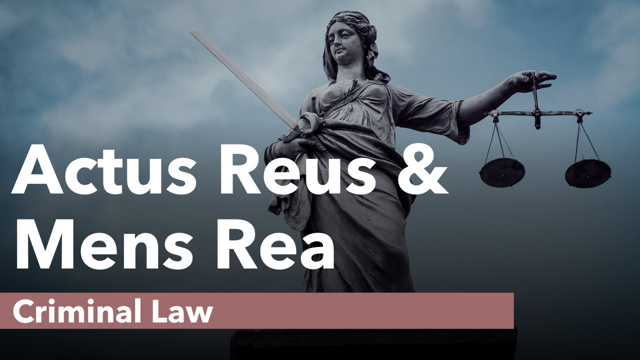
Elements of an offence
Every offence is made up of elements
Physical element(s)
  The act(s) or omission(s) by the accused & the circumstances in which those acts or omissions took place
Mental element(s) (or “fault” element)
  The intention(s) of the accused at the time they did the acts or made the omissions alleged, e.g. intention, knowledge, wilfulness, negligence or recklessness

Slide 12

Misappropriation, s 383A,Criminal Code, Papua New Guinea
383A(1) A person who dishonestly applies to his own use or to the use of another person–
property belonging to another; or ..
is guilty of the crime of misappropriation of property

Slide 13
Misappropriation, s 383A,Criminal Code, PNG
383A(1) A person who dishonestly applies to his own use or to the use of another person–
property belonging to another; or ..
is guilty of the crime of misappropriation of property
Elements:
Dishonestly
Applies
To his own use or the use of another person
Property
Belonging to another person

Slide 14
Misappropriation, s 383A,Criminal Code, PNG
Elements
The State must prove beyond reasonable doubt that a person:
Applies
To his own use or the use of another person
Property
Belonging to another person
Dishonestly
Havila Kavo v The State (2015) SC1450

Slide 15
Misappropriation – Property
What is “property” for the purpose of s 383A?
S 383A(3)(a) is very wide:
“property includes money and all other property real or personal, legal or equitable, including things in action and other intangible property”.
S 1(1), Interpretation, provides:
“property” includes every thing, animate or inanimate, capable of being the subject of ownership
“money” includes bank notes, bank drafts, cheques, and any other orders, warrants, authorities, or requests for the payment of money

Slide 16
Cf A thing capable of being stolen
Traditionally, anything capable of being stolen
An inanimate thing that is the property of any person and is moveable, or capable of being made moveable, even if it is made moveable in order for it to be stolen: S 362(1) Criminal Code, PNG

Slide 17
Misappropriation – Belonging to another person
To whom does property belong?
S 383A(3)(d):
“persons to whom property belongs include the owner, any part owner, any person having a legal or equitable interest in or claim to the property and any person who, immediately before the offender’s application of the property, had control of it.”

Slide 18
Misappropriation – Belonging to the State
Money allocated subject to conditions
When a sum of money is allocated to a person subject to conditions that it be applied in a certain way, it remains the property of the person who allocates the money unless and until it is applied in accordance with those conditions: Wartoto v The State (2019) SC1834; Kaya v The State (2020) SC2026 applying Brian Kindi Lawi v The State (supra).

Slide 19
Misappropriation – Applies to his own use or the use of another
The term “applies to his own use or the use of another” is not defined in the Criminal Code.
The ordinary meaning of the word “applies” is “to put to use; to employ, spend, dispose of". Oxford Short English Dictionary
“The section … stops short of requiring that there should be some consumption, expenditure or dissipation of the thing, alteration of its form or utilisation of it to secure some collateral material benefit, although these may be involved. I consider that the requirement of this part of the section is met when there has been a utilisation by the person involved for his own purposes…The "application" will involve some deflection from the purposes of the person to whom the property belongs”: R v Easton [1994] 1 Qd R 532, adopted and applied S v Hasu (2018) N8656.

Slide 20
Cf Fiji – Theft, S 291(1), Crimes Decree
S 291(1) of the Crimes Decree, 2009 creates the offence of theft in that jurisdiction:
(1) A person commits a summary offence if he or she dishonestly appropriates property belonging to another with the intention of permanently depriving the other of the property.
S 293 (1) for the purposes of this Division:
any assumption of the rights of an owner to ownership, possession or control of property, without the consent of the person to whom it belongs, amounts to an appropriation of the property.

Slide 21
Misappropriation, s 383A – Dishonestly
Subjective Test: The State must establish that:
What the accused did was dishonest according to the standards of ordinary honest people, and
The accused in fact knew that what they were doing was dishonest according to those standards
But in determining whether the accused knew that what they were doing was dishonest, you may take into account the standards of ordinary honest people, ie whether it might reasonably be inferred that the accused must in fact have known that he or she was acting dishonestly: Brian Kindi Lawi v The State [1987] PNGLR 183; Wartoto v The State (2019) SC1834; Havila Kavo

Slide 22

Cf Intention to Permanently Deprive
To treat as the person’s own to dispose of regardless of the other’s rights

Slide 23
Obtaining by False Pretence, s 404, Criminal Code, PNG - Elements
Elements
By
A false pretence (or a wilfully false promise, or partly by a false pretence and partly by a wilfully false promise)
Obtains from another person
Any chattel, money or valuable security
With intent to defraud

Slide 24
Obtain by False Pretence, s 404, Criminal Code, PNG
Obtain
Traditionally and still in several jurisdictions, the accused must obtain ownership and not merely possession: Amaiu v The State [1979] PNGLR 576.
But several jurisdictions across the Pacific have expanded the meaning of “obtain” in the legislation to include possession or control, eg :
“the person obtains ownership, possession or control of it for himself or herself or for another person”; or … 317(1)(a) Fiji Crimes Decree

Slide 25

Intention to Defraud
An intention to deprive a person of property which is his or to which he might be entitled, or to put the property of that other person at risk, or to imperil some lawful right, interest, opportunity or advantage of another person; by using deceit, or fraudulent or dishonest means; knowing that he has no right to deprive that person of that property or to prejudice those rights or interests.
Roland Tom v State (2019) SC1833 applying Scott v Metropolitan Police Commissioner [1975] AC 819 and Peters v The Queen [1998] HCA 7; (1998) 192 CLR 493

Slide 26
Defence – Honest Claim of Right
A person is not criminally responsible, as for an offence relating to property, for an act done or omitted to be done by him with respect to any property in the exercise of an honest claim of right and without intention to defraud
S 23(2), Criminal Code, PNG

Slide 27

Defence – Honest Claim of Right
the act done or omitted to be done must be or omitted to be done with respect to property;
in the exercise of an honest claim of right; and
without intention to defraud

Slide 28
Defence – Honest Claim of Right
The accused must honestly believe he is entitled to do what he is doing with respect to the property the subject of the charge
The belief must be one of legal entitlement to the property and not simply moral entitlement
A claim of right must be honest, it does not have to be reasonable.
It is an excusatory defence and must be excluded beyond reasonable doubt by the State once raised on the evidence.

Slide 29
Defence – Honest Claim of Right
Honest and without intention to defraud
If dishonesty is an element, and where there is a subjective test, it is a different way of asking whether dishonesty has been established, ie did the accused honestly believe they were entitled to do what they did with respect to the property the subject of the charge?
For an offence like obtaining by deception, the mere fact that there was a deception will not necessarily be enough to exclude the claim of right, but in many cases it will be strong evidence that the acts were done dishonestly.
In addition, has the prosecution excluded the possibility that the accused act without an intention to defraud.

Slide 30

In closing
Regardless of the jurisdiction, the paramount consideration will be the elements of the offence as prescribed in the relevant legislation and the requirements of those elements having regard to:
  What constitutes the subject of the charge - whether it is “property” or some other thing
  Who owns or has an interest in that property or thing
  What the accused must do with respect to that property or thing and
  With what intention

Slide 31
Discussion
Session 2: Fraud and Related Offences Scenario Discussion
Breakout room discussions

Slide 32
Discussion
Session 2: Fraud and Related Offences Scenario Discussion
Scenario Questions have been emailed to you

Slide 33

Next Week:
Session 3 - Bribery & Corruption
Wednesday 31 May
12-2pm (GMT +10:00)
New Zoom link will be sent
Session 3 Bribery & Corruption Case Scenario that will be emailed to you
Come to session ready to discuss
Judicial Facilitator: Justice Berrigan

Slide 34
Due to varying locations, local time zones for the discussion are as follows:
Wednesday 31 May, 2023
11:00am | Koror, Palau
11:30am | Adelaide, Australia
12:00pm | Brisbane, Australia Port Moresby, Papua New Guinea
1:00pm | Pohnpei, Federated States of Micronesia Honiara, Solomon Islands Port Vila, Vanuatu
2:00pm | Suva, Fiji Tarawa, Kiribati Yaren, Nauru Majuro, Republic of Marshall Islands
3:00pm | Nukualofa, Tonga Apia, Samoa Fakaofo, Tokelau

Slide 35
See you next week!

