Slide 1


Slide 2

Introduction

Slide 3
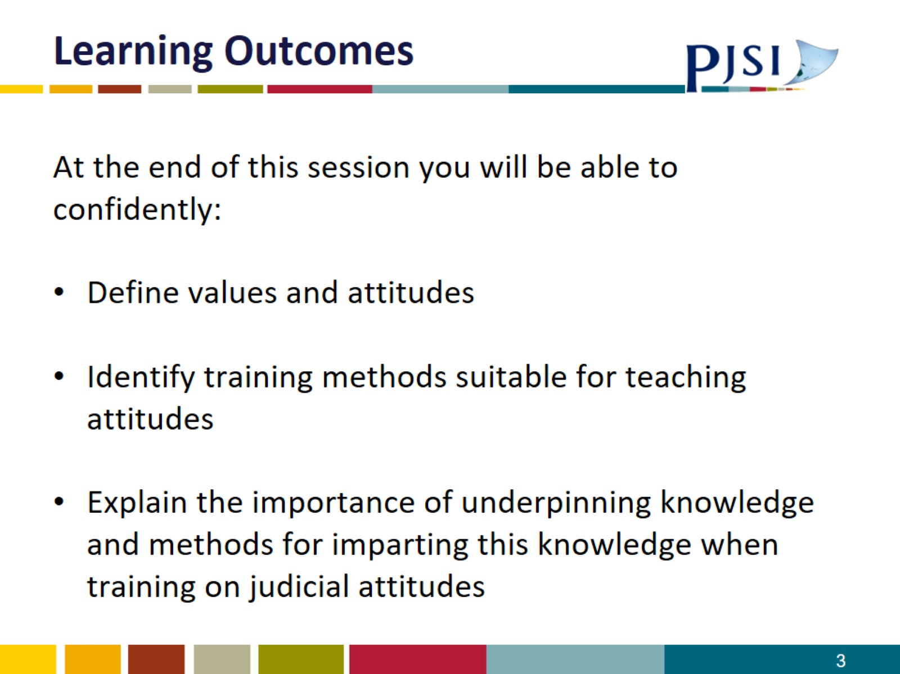
Learning Outcomes

Slide 4
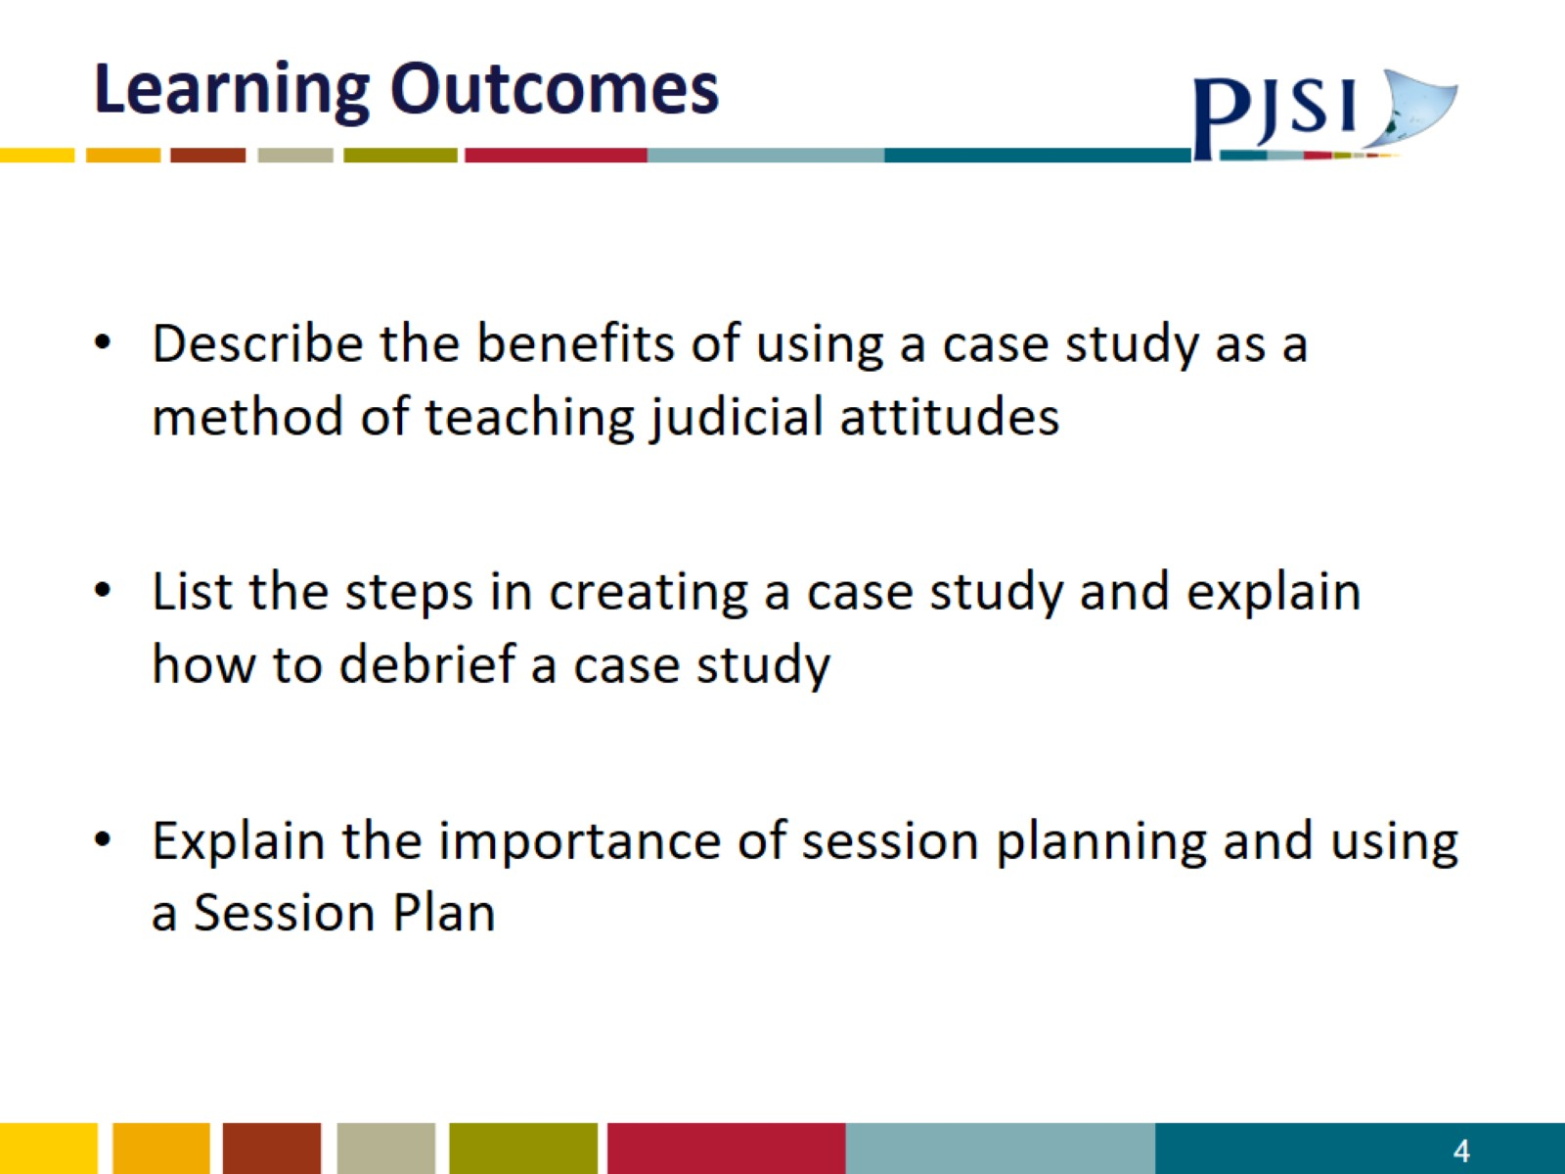
Learning Outcomes

Slide 5
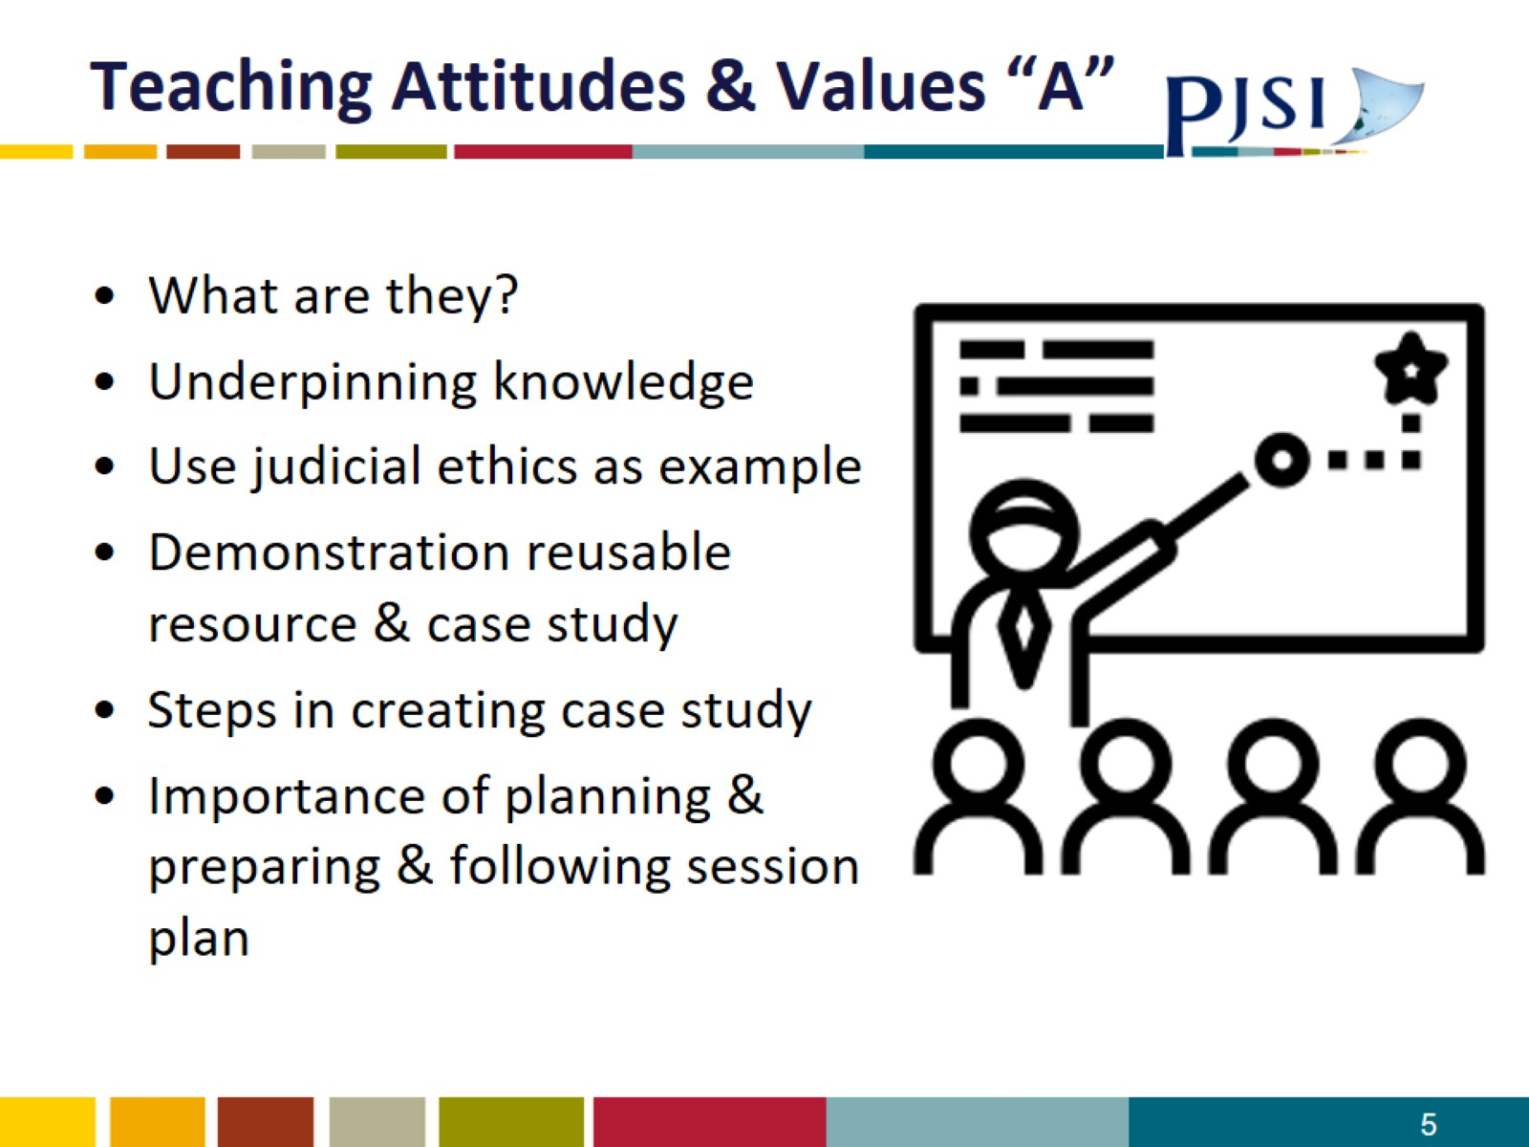
Teaching Attitudes & Values “A”

Slide 6
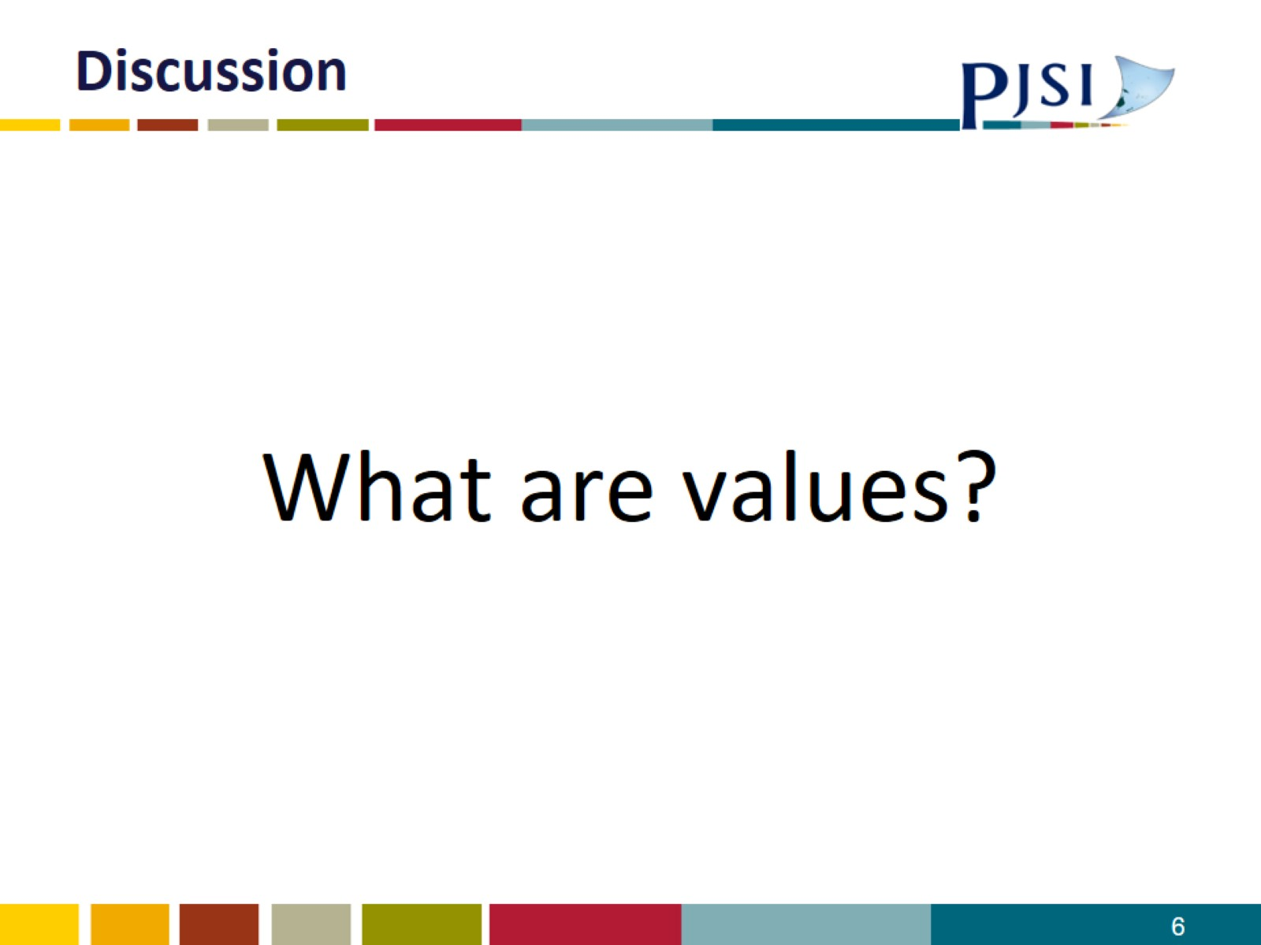
Discussion

Slide 7
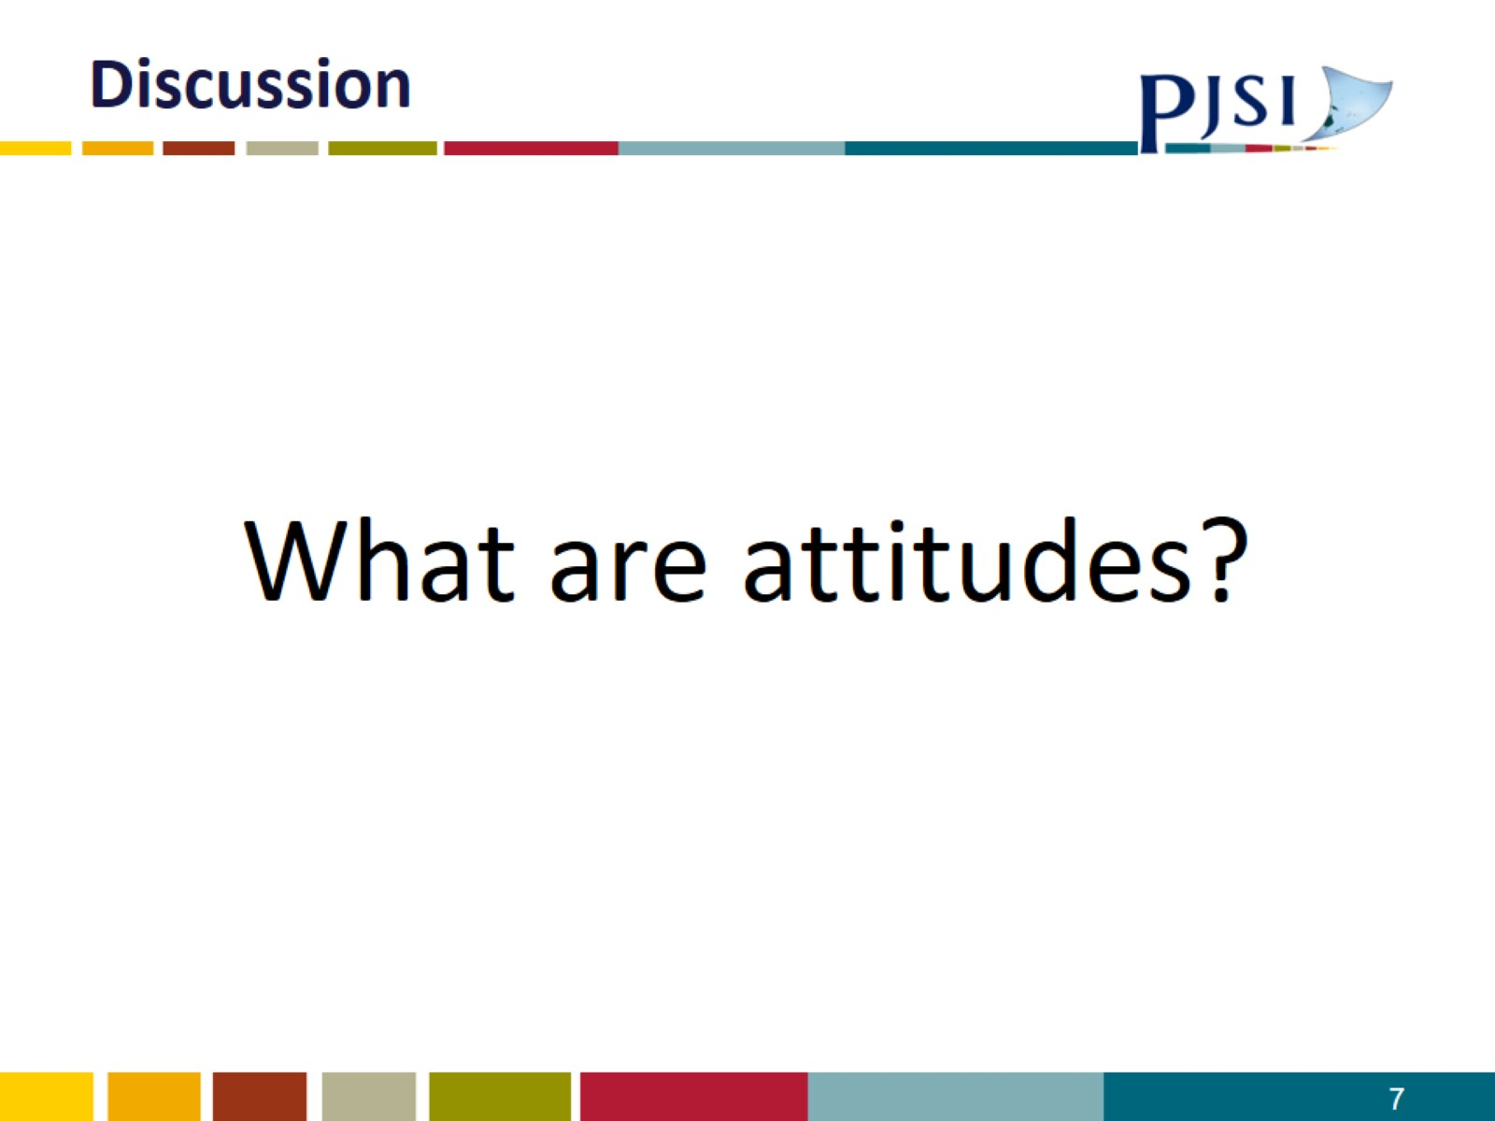
Discussion

Slide 8
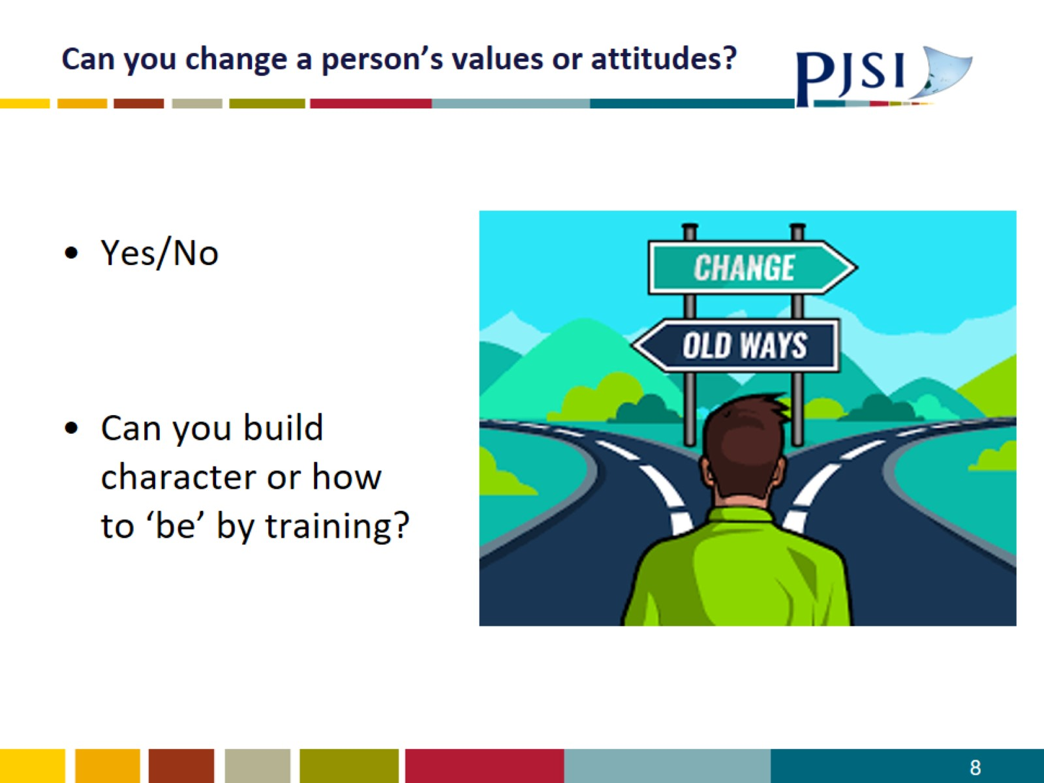
Can you change a person’s values or attitudes?

Slide 9
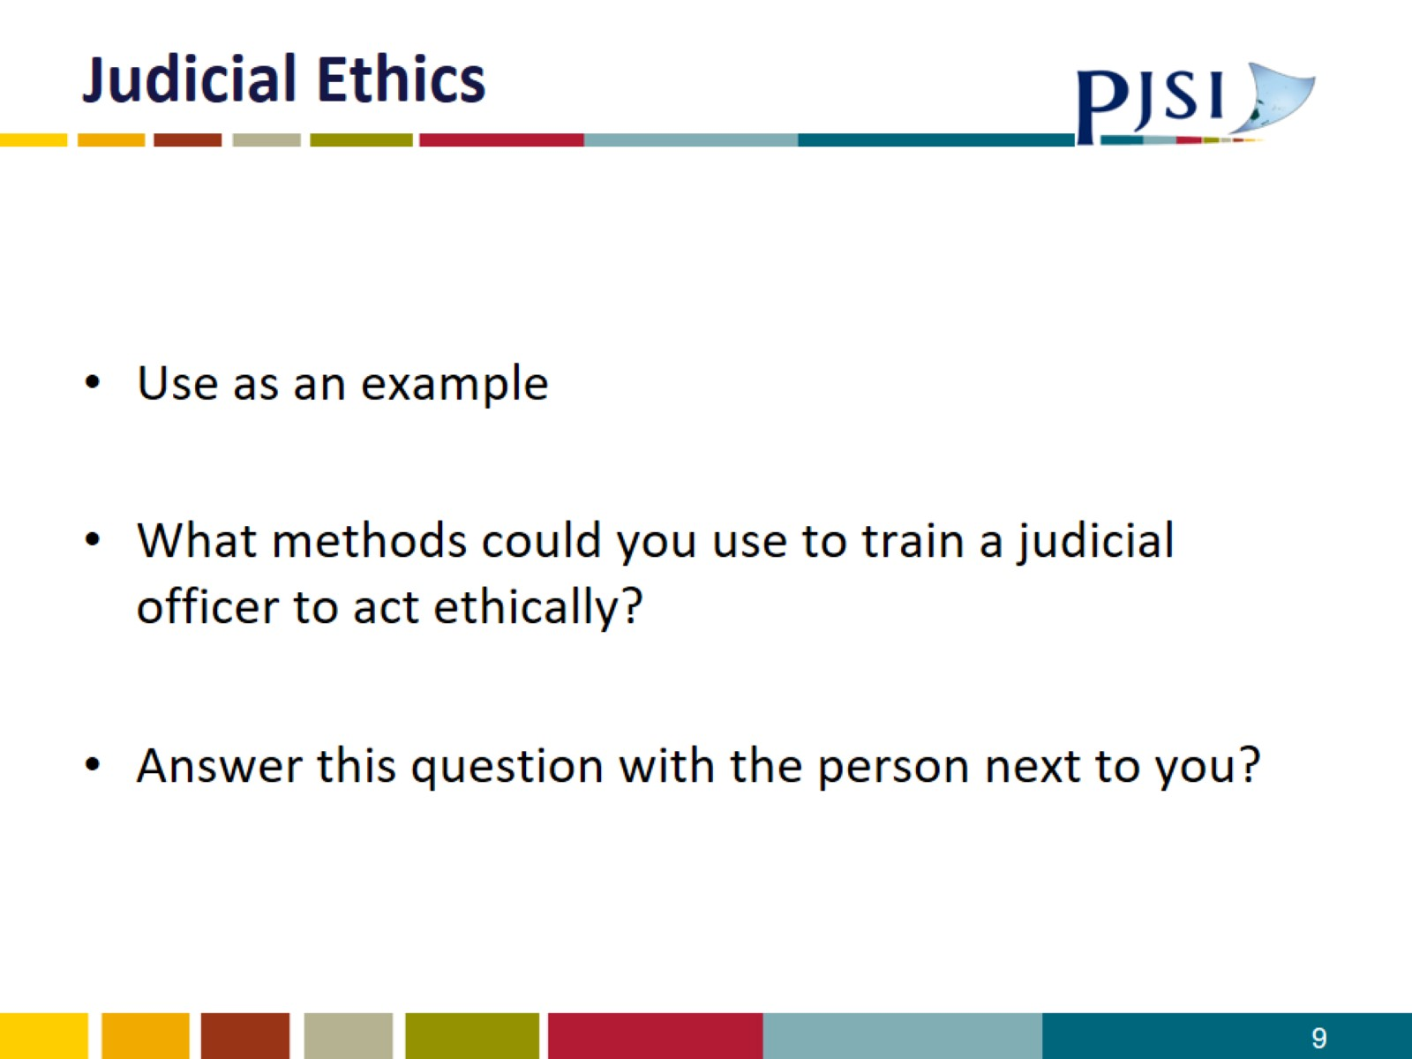
Judicial Ethics

Slide 10
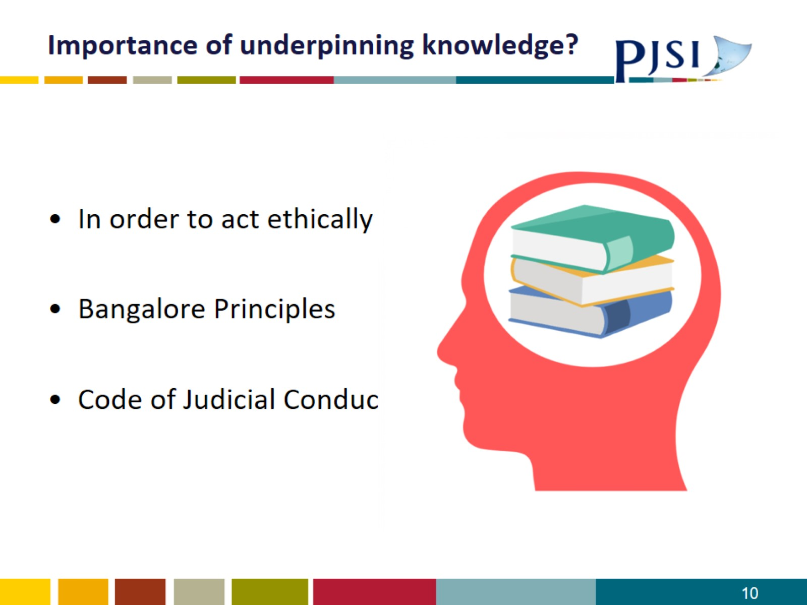
Importance of underpinning knowledge?

Slide 11
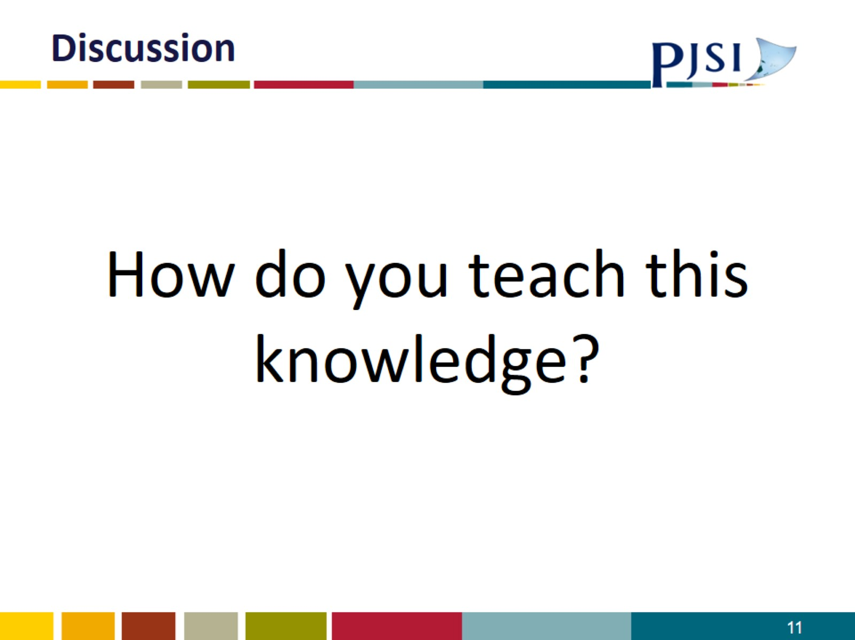
Discussion

Slide 12
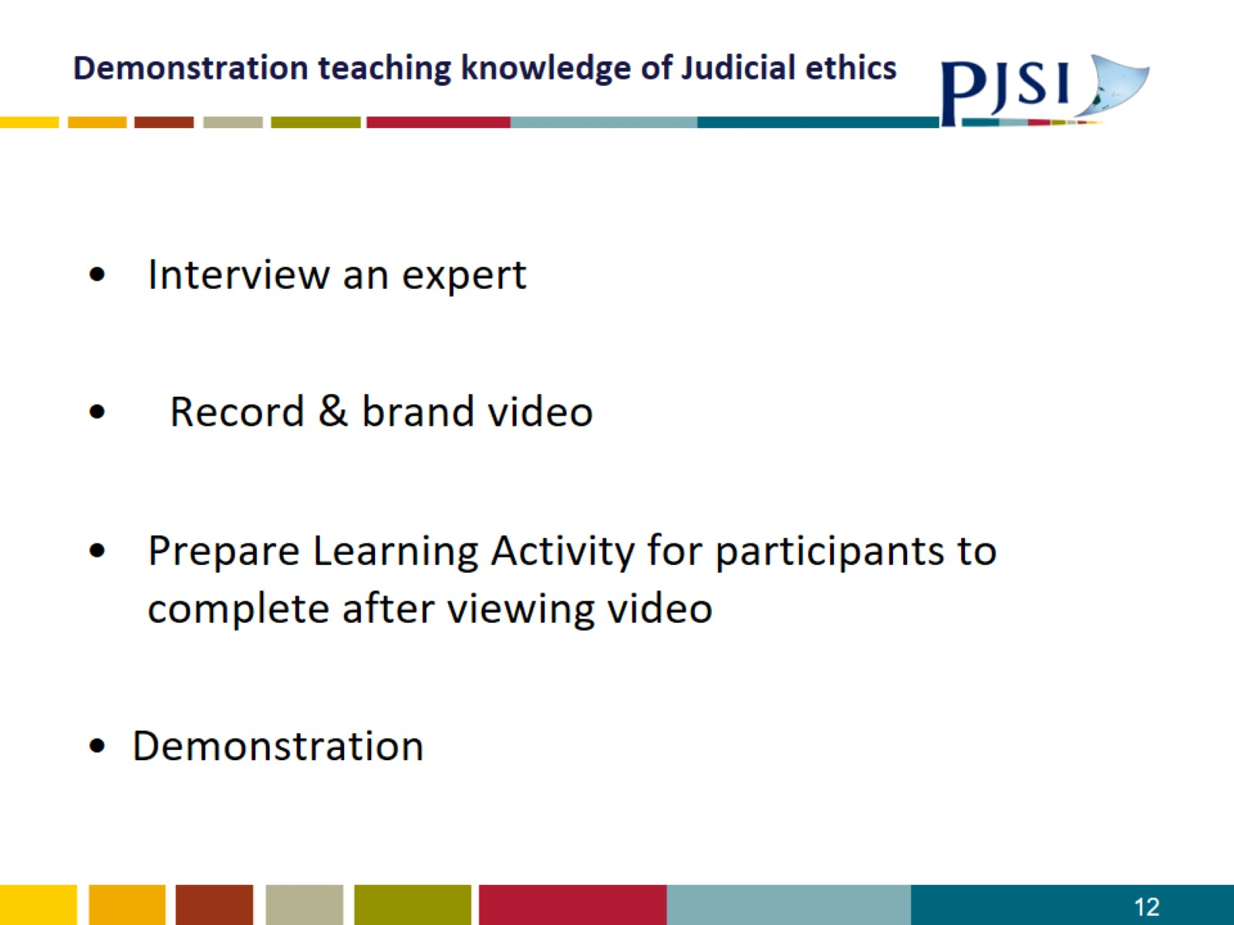
Demonstration teaching knowledge of Judicial ethics

Slide 13

Video

Slide 14
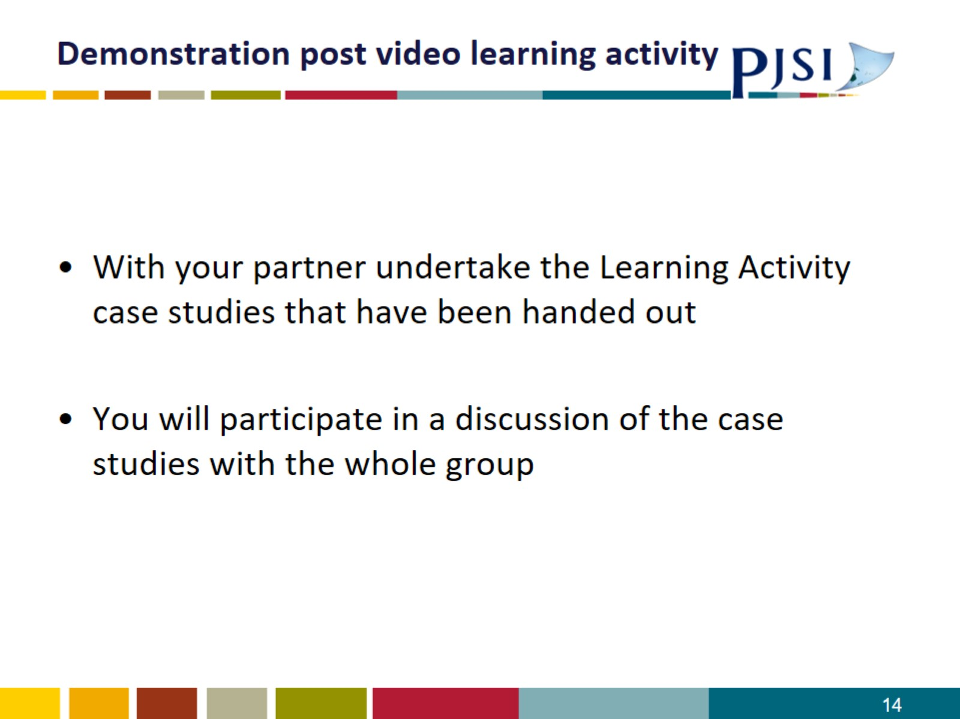
Demonstration post video learning activity

Slide 15
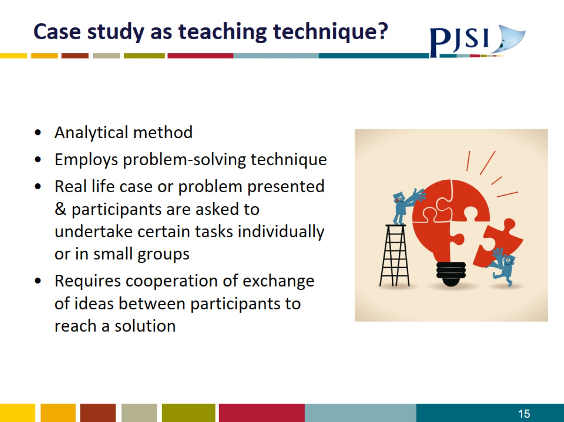
Case study as teaching technique?

Slide 16
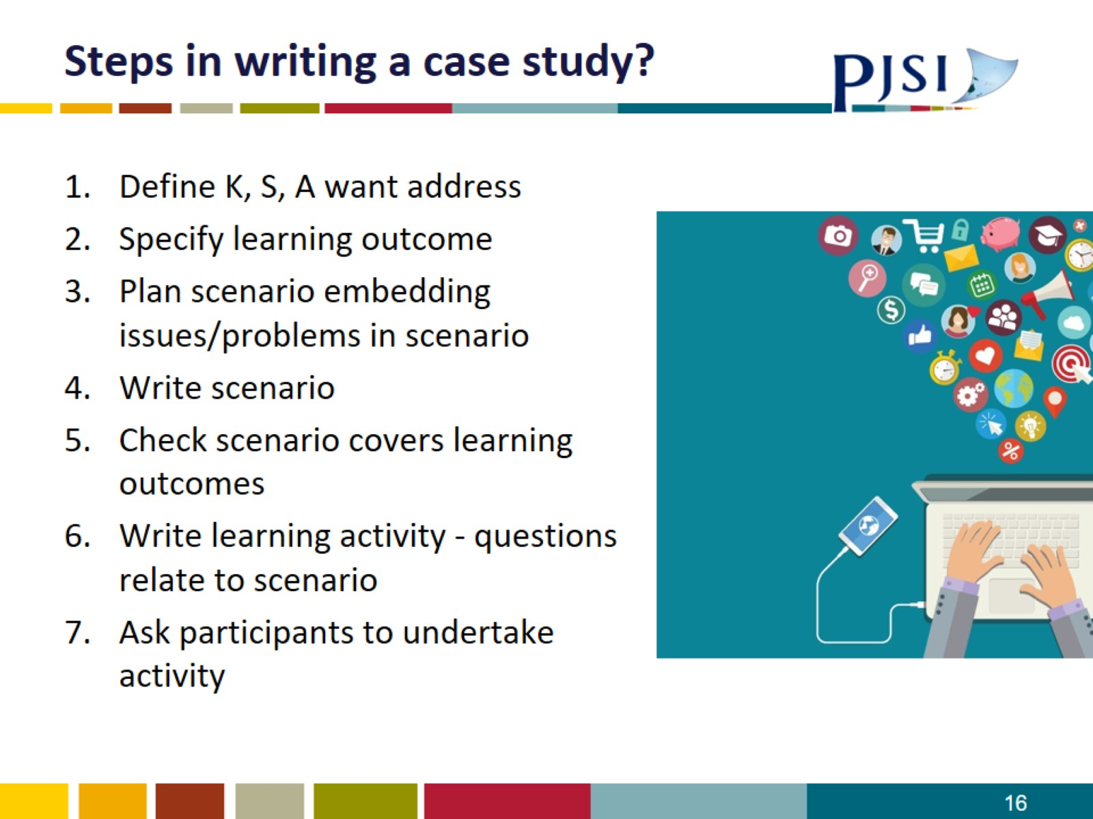
Steps in writing a case study?

Slide 17
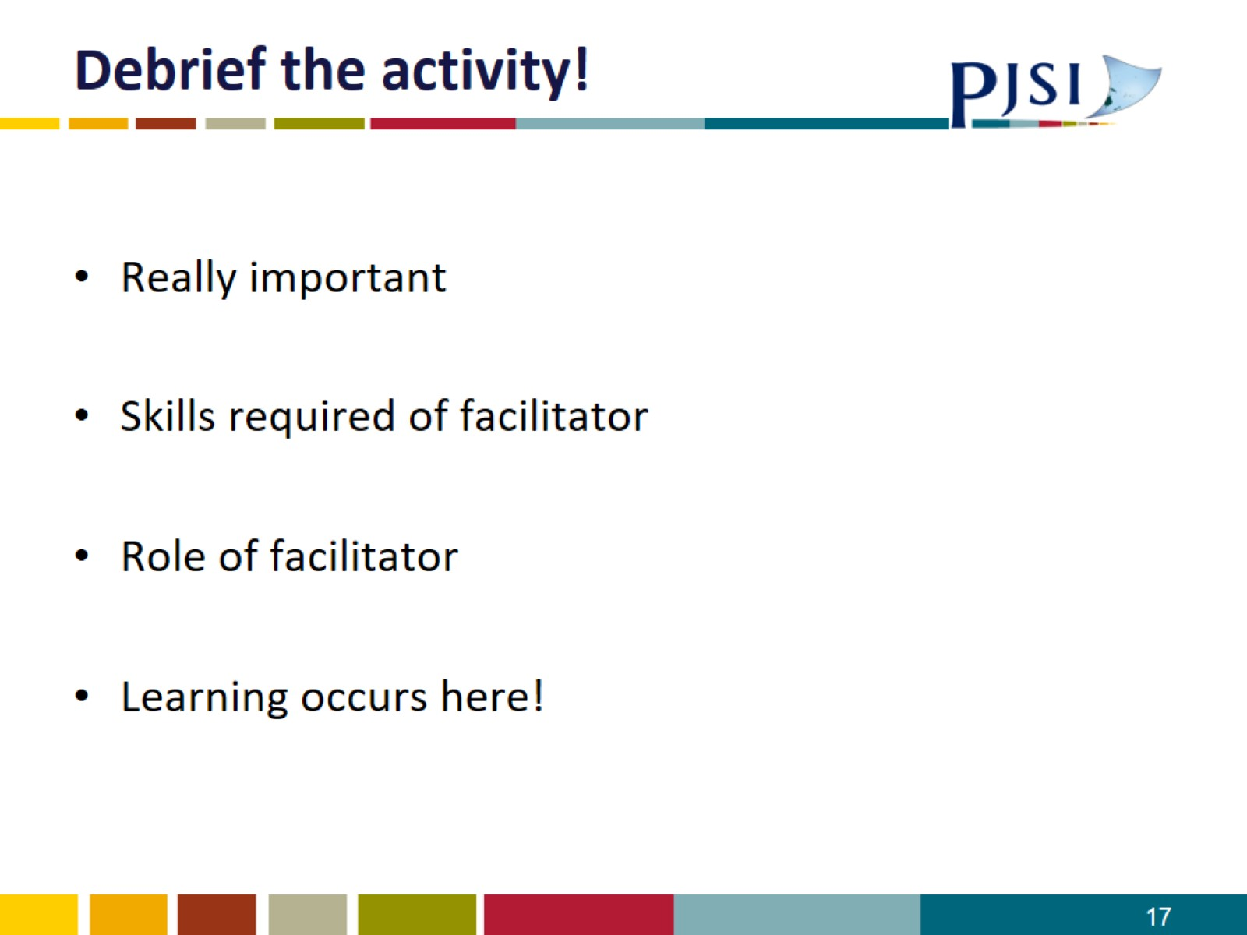
Debrief the activity!

Slide 18
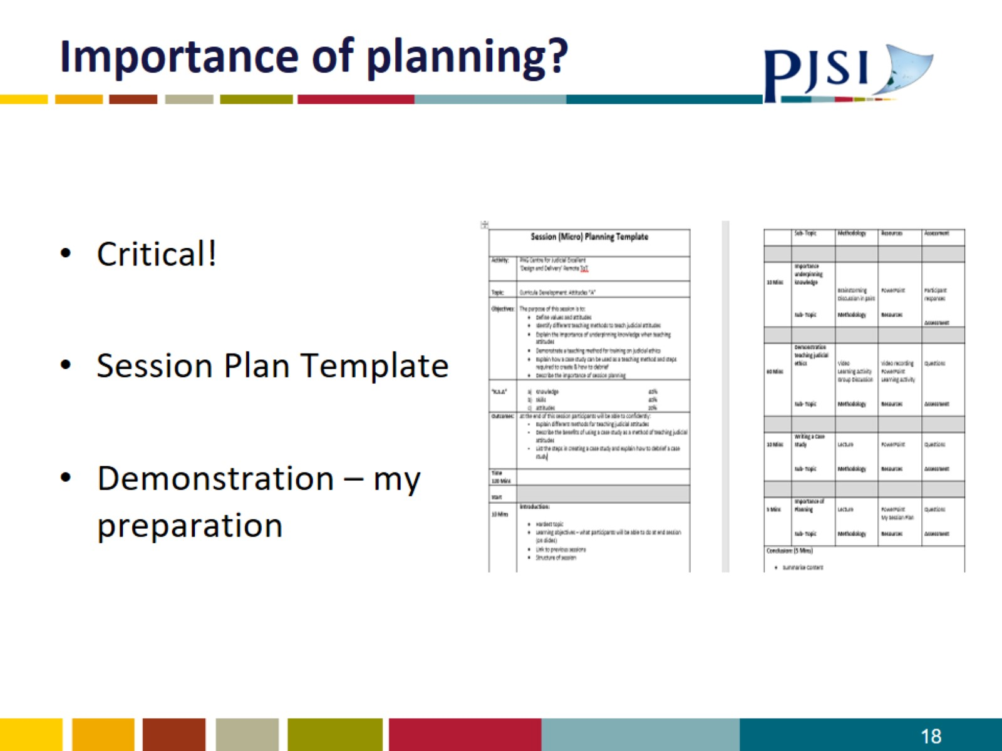
Importance of planning?

Slide 19
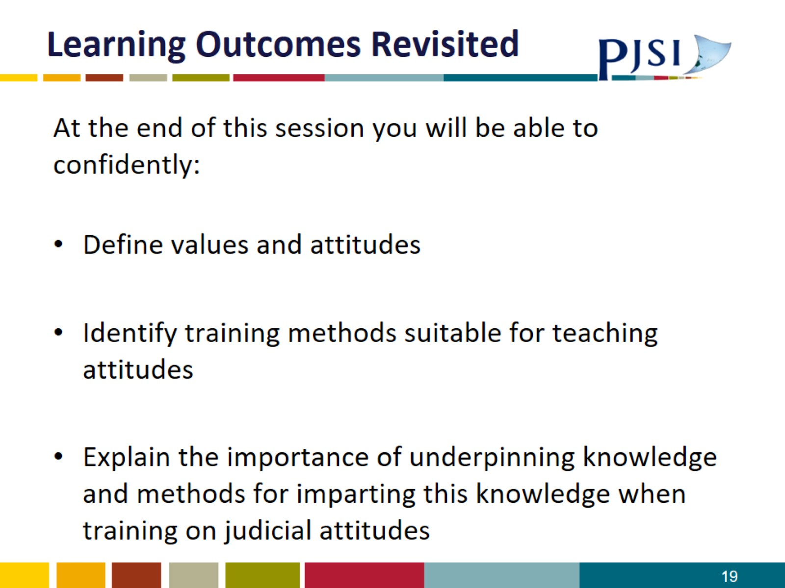
Learning Outcomes Revisited

Slide 20
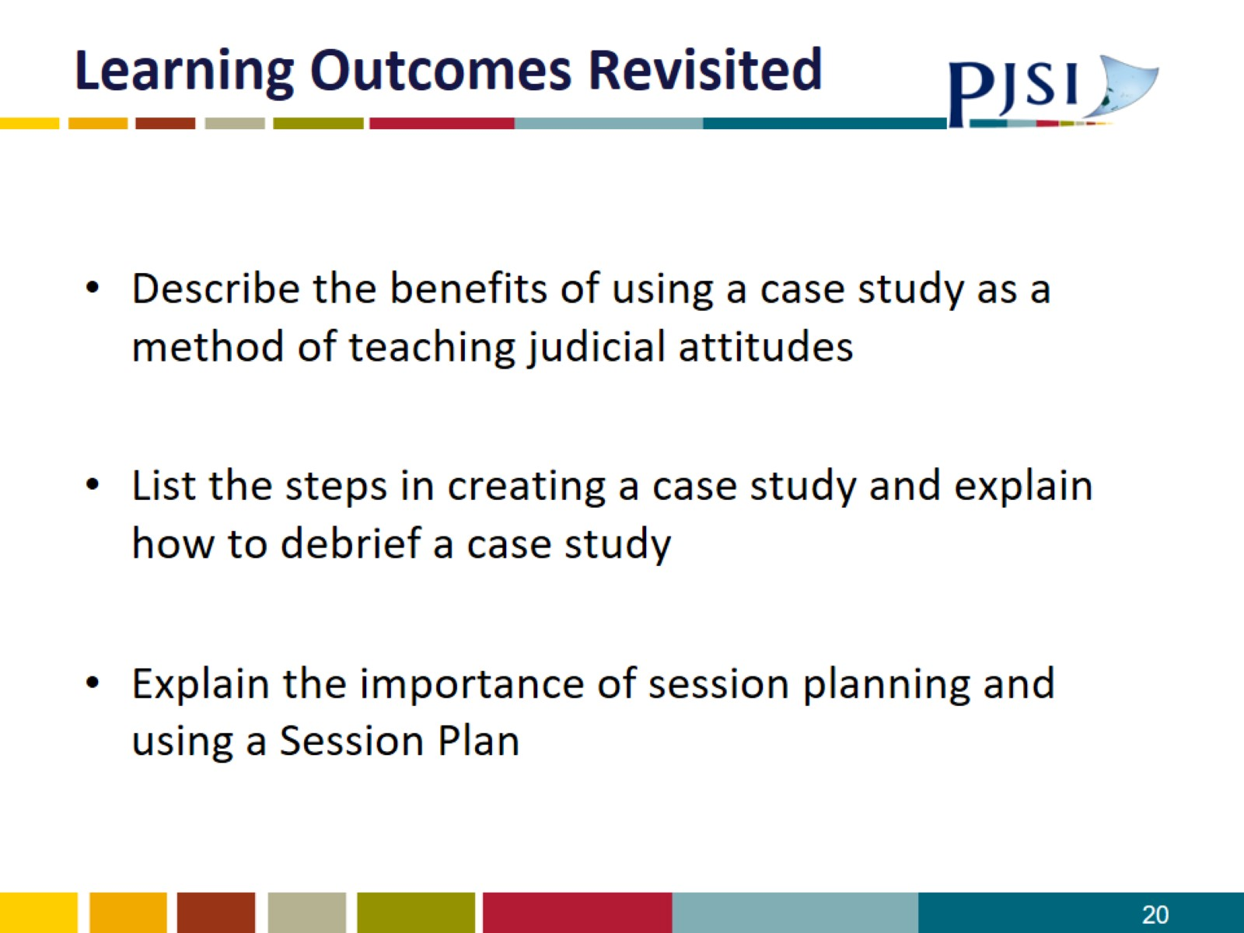
Learning Outcomes Revisited

