Slide 1



Developed as a resource for the:
Pacific Judicial Strengthening Initiative is funded by the New Zealand Government and implemented by the Federal Court of Australia

Slide 2
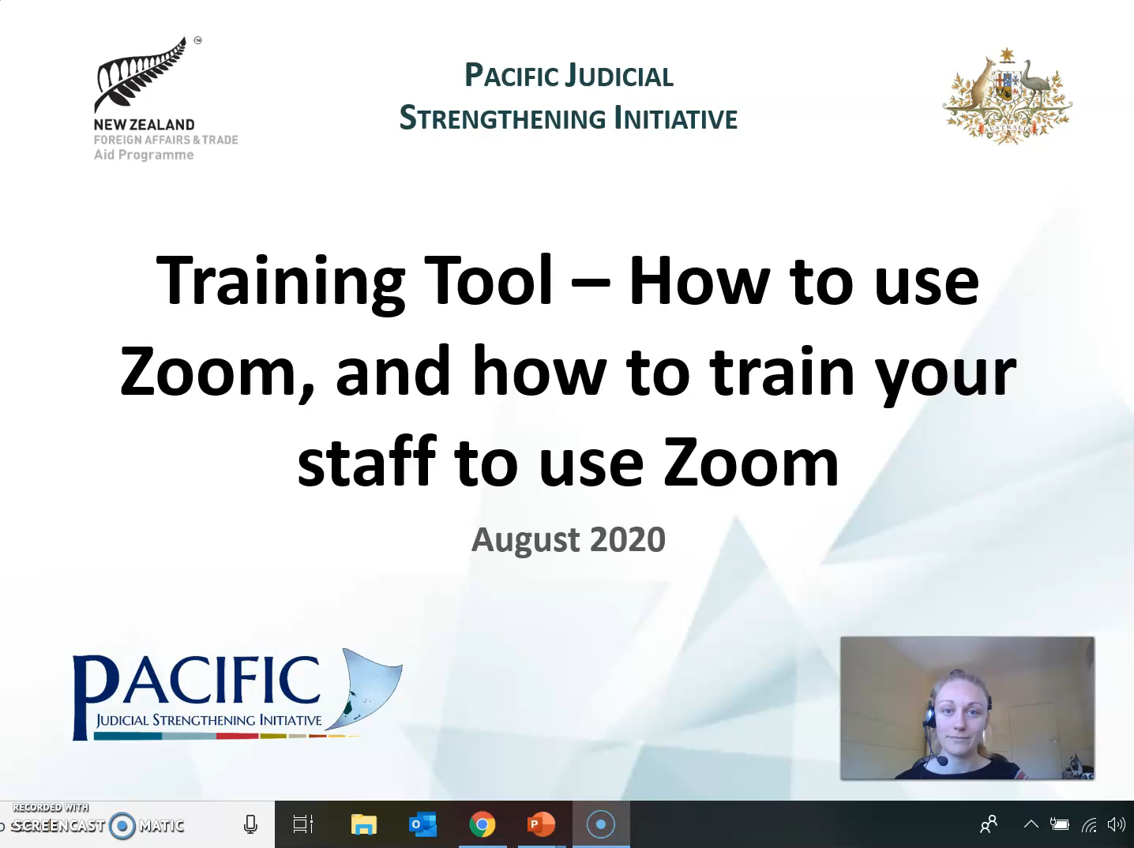

Slide 3

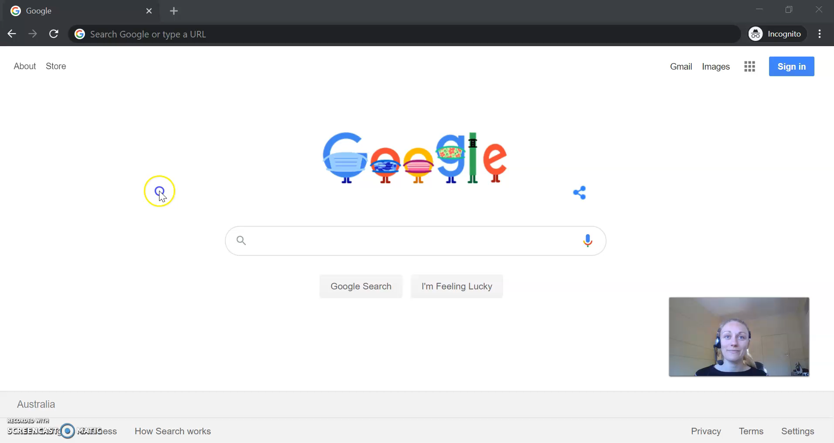
Pacific Judicial Strengthening Initiative
Scheduling a Zoom Meeting

Slide 4
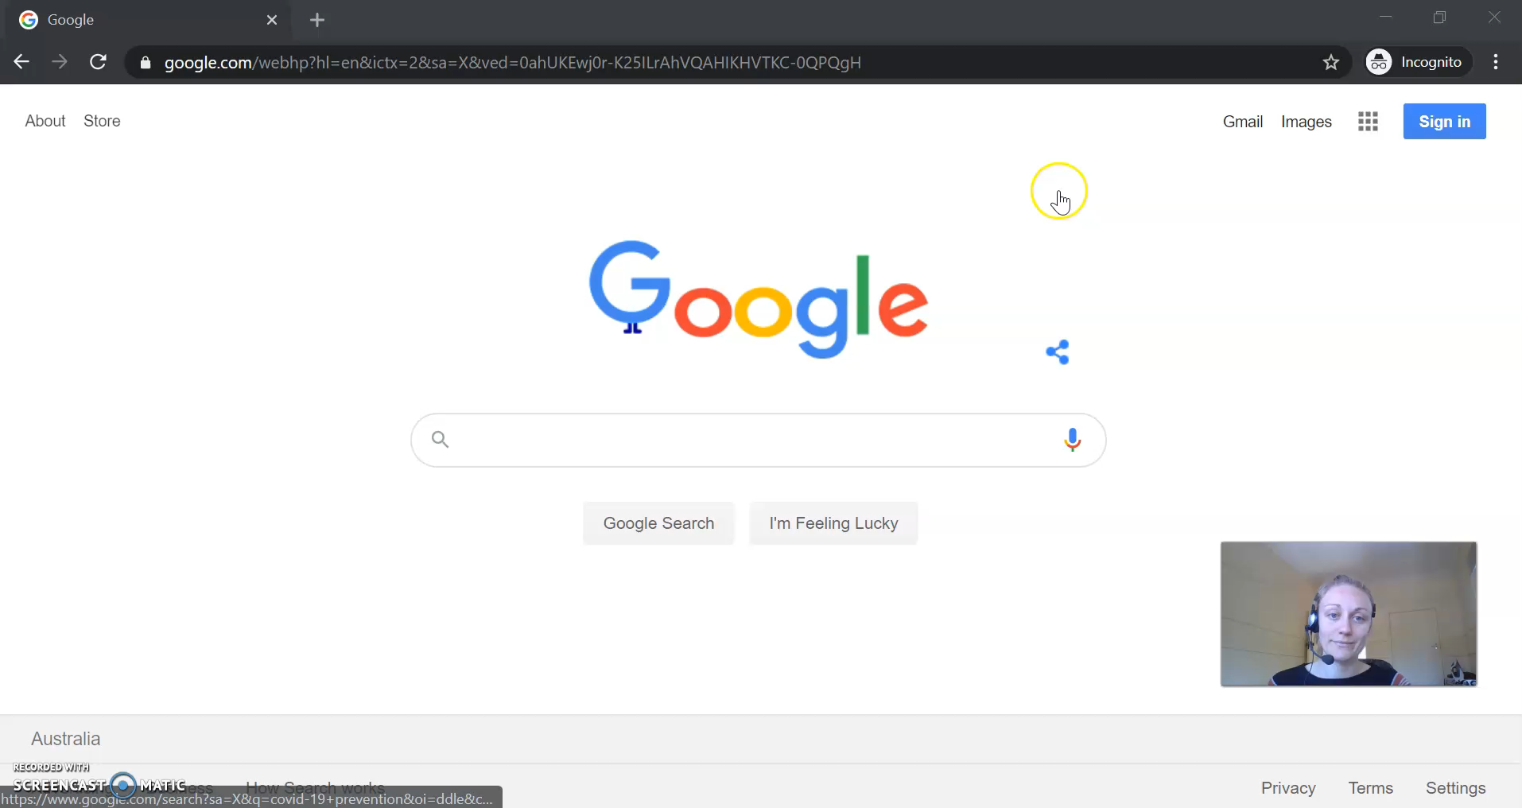
Pacific Judicial Strengthening Initiative
Starting a Zoom Meeting

Slide 5
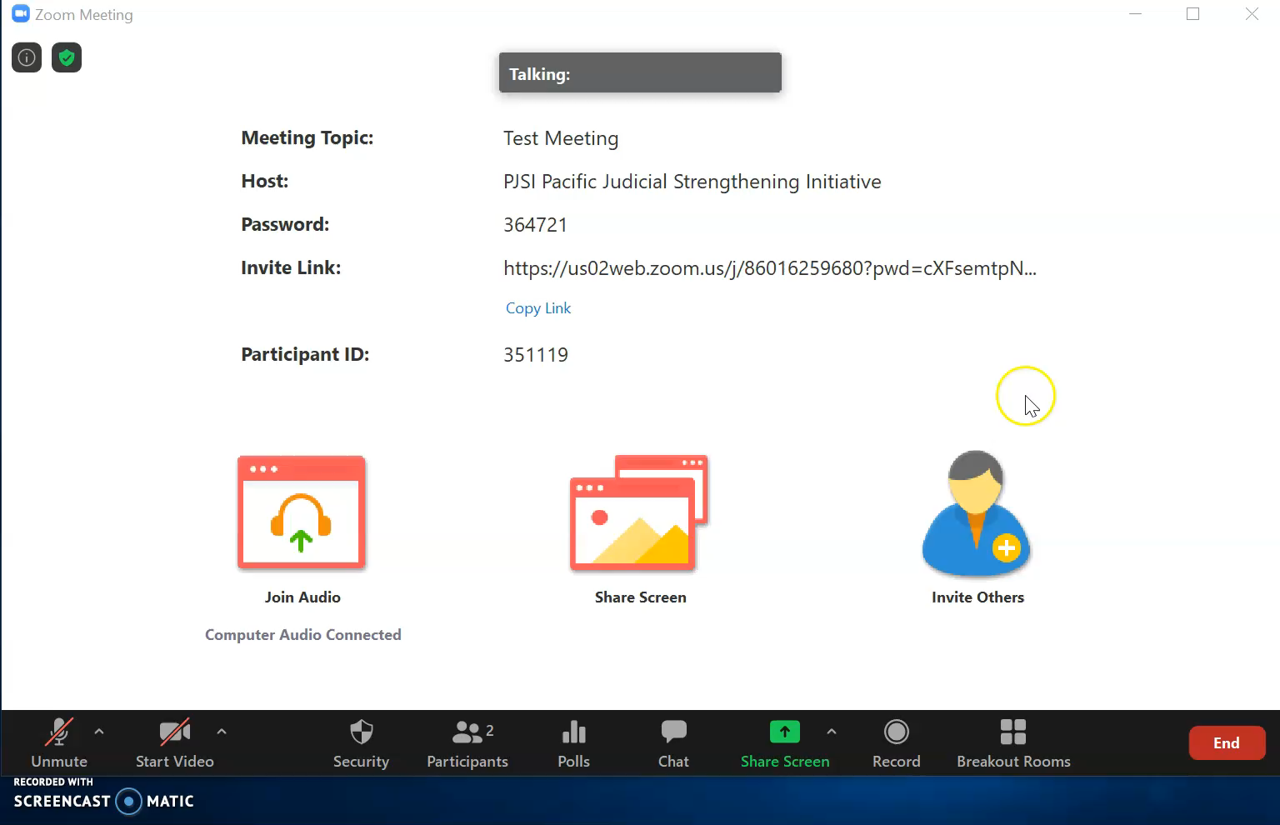
Pacific Judicial Strengthening Initiative
Host Functions

Slide 6
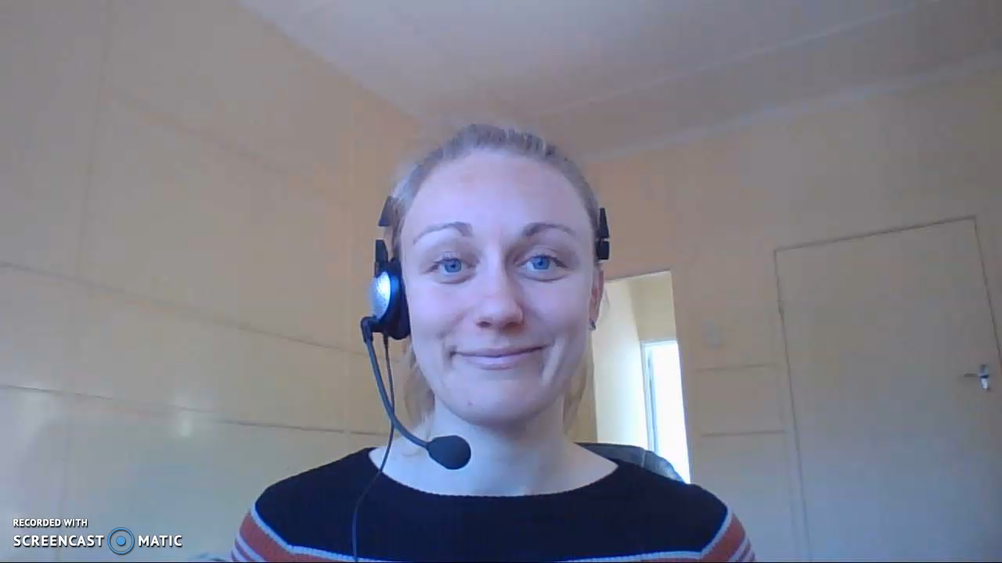
Pacific Judicial Strengthening Initiative
Wrap Up

Slide 7
Developed as a resource for the:
Pacific Judicial Strengthening Initiative is funded by the New Zealand Government and implemented by the Federal Court of Australia

