Slide 1



Judicial Officers’
Fraud and Corruption Online Course
Via Zoom - 18, 25 & 31 May, 8 & 15 June 2023

Slide 2
Session 5: Evidence
Thursday 15 June, 2023
Honourable Chief Judge Brian Devereaux SC
Honourable Judge Brad Farr SC
District Court of Queensland

Slide 3

Session 5: Evidence
Welcome & Introduction (5 minutes)
Chief Judge Devereaux & Judge Farr’s presentation (30 minutes)
Questions & Answers on presentation (15 minutes)
Scenario Questions on Evidence (40 minutes)
Session Wrap-Up (5 minutes)
Course Wrap-Up (20 minutes)

Slide 4

Evidentiary effect of documents
Once a document is admitted:
The Court must determine what the document/statement contained therein is evidence of?
What weight should be attached to it?
The fact a document is admitted does not mean it will be accepted by the court or weight will be given to it. No different from oral testimony.
What should the court play close attention to?

Slide 5

What is a ‘document’?
Evidence Act 1995 (Cth) definition.
Evidence Act 1977 (Qld), in contrast.
How does your jurisdiction define a ‘document’?

Slide 6
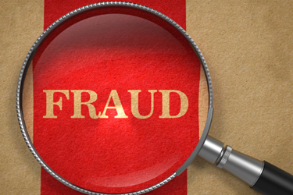
Fraud trials most documents are:
In the form of business records, bank records, ledgers, invoices, receipts etc and, email exchanges.
Discussion of business records.
Discussion of emails – may include third party emails (exception to the hearsay rule).

Slide 7
Refreshing memory from
documents
Usually, a witness is not permitted to consult a contemporary note until his/her memory of the event is exhausted.
Exceptions – what are they?

Slide 8
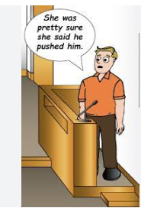
Rule against hearsay
Is based on the policy of excluding unreliable evidence.
Forbids the repetition of a prior statement to the witness by another, if the purpose is to assert that the facts contained within the statement are true.
Applies equally to evidence elicited in evidence-in-chief and to cross-examination.

Slide 9
Rule against hearsay
Hearsay evidence may be unreliable.
Absence of opportunity to cross-examine on it, because the alleged author of the statement in question is not the witness.
Witnesses are only permitted to give evidence as to the matters that they personally experienced/ witnessed/heard.

Slide 10
Rule against hearsay
Not every repetition of another’s statement infringes the hearsay rule
Why?

Slide 11
Exceptions to the rule against
hearsay
Res gestae utterances
Admissions
Confessions
Statements of deceased persons
Statements in public documents
Evidence in earlier proceedings; and
Recent complaint and sexual offence cases

Slide 12
Documentary exceptions to the
rule against hearsay
Books of account
Documents used testimonial in criminal cases
Things produced by processes or devices
Prior inconsistent statements in writing
Expert evidence

Slide 13
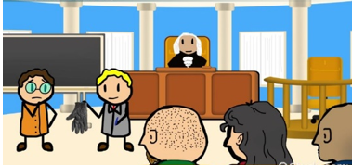
Circumstantial Evidence
Definition: evidence of circumstances which can be relied upon not as proving a fact directly but instead as pointing to its existence.

Slide 14
Circumstantial Evidence
Differs from direct evidence, how?
What if only evidence against defence is circumstantial?
Must each part of circumstantial evidence be proved?

Slide 15
Circumstantial Evidence
Circumstantial evidence may be only evidence of intent of defendant.
Must assess circumstantial evidence as a whole.
Weight is to be given to any piece of circumstantial evidence, depending upon the nature of the evidence, the issues in contest and the strength of other evidence.

Slide 16

Parties to an offence
Queensland position: Section 7(1) of the Criminal Code Act 1899 (QLD) : When an offence is committed, each of the following persons is deemed to have taken part in committing the offence and to be guilty of the offence, and may be charged with actually committing it …
Section 8 of the Criminal Code Act 1899 (QLD) deals with counselling another to commit an offence, and the consequences if an offence is committed.
Section 9 of the Criminal Code Act 1899 (QLD) deals with when two or more persons form a common intention to prosecute an unlawful purpose in conjunction with one another.

Slide 17
Section 10A of the Criminal Code
Act 1899 (QLD) provides:
Under section 7 a person’s criminal responsibility extends to any offence that, on the evidence admissible against him or her, is either the offence proved against the person who did the act or made the omission that constitutes that offence or any statutory or other alternative to that offence.
Discussion of R v Taylor.
Application of section 7(1) (a).

Slide 18
Section 10A of the Criminal Code
Act 1899 (QLD) provides:
To establish criminal responsibility under s 7(1)(b) or s 7(1)(c), the prosecution must prove that the defendant knows “the essential facts constituting or making up the offence that is being or about to be committed by the person he is aiding or assisting”.
Discussion of aiding and procuring.
What are the defences?

Slide 19
Withdrawal as a party to an offence
Whether the defendant has withdrawn from a common purpose, or from a role enabling, aiding, counselling or procuring an offence, may arise as a question of fact relevant to whether the offence has been committed, rather than as constituting a defence.

Slide 20
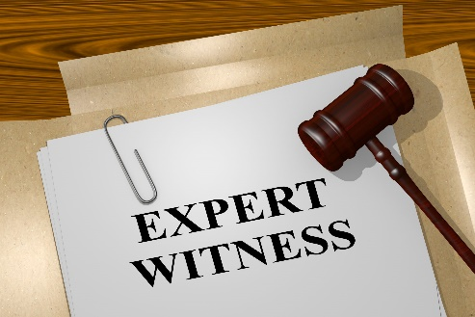
Expert witnesses
“In matters of trade or business, the opinion of an expert, or a person intimately acquainted with it is admissible to furnish the court with information which is likely to be outside the experience or knowledge of a judge or jury. But, if on the proven facts, a judge or jury can form their own conclusions without help, then the opinion of an expert is unnecessary”. (Archbold, 2017)

Slide 21
Matters court should have regard
to with respect to expert witnesses
Qualifications of the expert.
Whether the witness was impartial or partial to either side.
Does the opinion accord with whatever other facts the fact finder finds proved?
Have the facts, from which the expert’s opinion is based, been established?
Expert should be independent, impartial and uninfluenced by the potential outcome of the case.

Slide 22
Matters court should have regard
to with respect to expert witnesses
What if the expert has a conflict of interest?
Competing expert witnesses.
An expert can’t prove disputed facts by inadmissible hearsay.
Most common types of expert testimony in fraud trials from forensic accountants + fingerprint experts.

Slide 23
Matters court should have regard
to with respect to expert witnesses
Courts can allow expert witnesses to have their written report in front of them whilst giving evidence.
Juries must be directed as to the way in which they can treat expert evidence.
Persons qualified to express an expertise opinion are permitted to do so on relevant matters within the field of their expertise.
An ‘expert’ witness does not mean their evidence has to be automatically accepted – as judge you make this decision.

Slide 24
Common defences in fraud cases
in Queensland
Honest claim of right and mistake of fact.
Law will not necessarily be the same in your jurisdiction.
Section 22(1) in Qld re honest claim of right and section 24 for mistake of fact.

Slide 25

Honest claim of right. Factors
need to prove:
That he/she honestly believes himself or herself to be entitled to do what he or she is doing.
Need not be reasonable but can’t be with an intention to defraud.
Does not matter if the right asserted by the belief is one which is unfounded in law or fact.
The question of fact not law as to whether a person was acting under an honest claim of right.

Slide 26
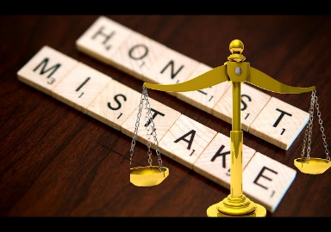
Mistake of fact defence (Qld)
A person who does or omits to do an act under an honest and reasonable but mistaken belief in the existence of any state of things, to the same extent as if the real state of things had been such as the person believed to exist.

Slide 27
Mistake of fact defence (Qld)
Excuse is distinct from a defence, and is a matter which the prosecution must negate beyond reasonable doubt.
Defendant does not have to give evidence but there must be some evidence, looking at the case as a whole, of operative mistake.
Mistake must be one of fact and not of law.

Slide 28
Mistake of fact defence (Qld)
Belief must be positively held - mere inadvertence will not suffice.
Must be an honest belief and a reasonable belief – held by defence on reasonable grounds.
Defence can be claimed by corporations.
Complications with this defence.

Slide 29
Discussion
Session 5: Evidence Scenario and Questions

Slide 30

Questions

Slide 31
Feedback

Slide 32
Upcoming PJIP activities
Self-paced workshop for judges
Second in-person workshop for judges
Judicial Networking and Mentoring Program
  Evidentiary Issues webinar
  Unconscious bias in judicial decision-making webinar
Online live & self-paced course for court staff
Second in-person workshop for court staff
Resources

Slide 33
Thank you!

